Slide 1
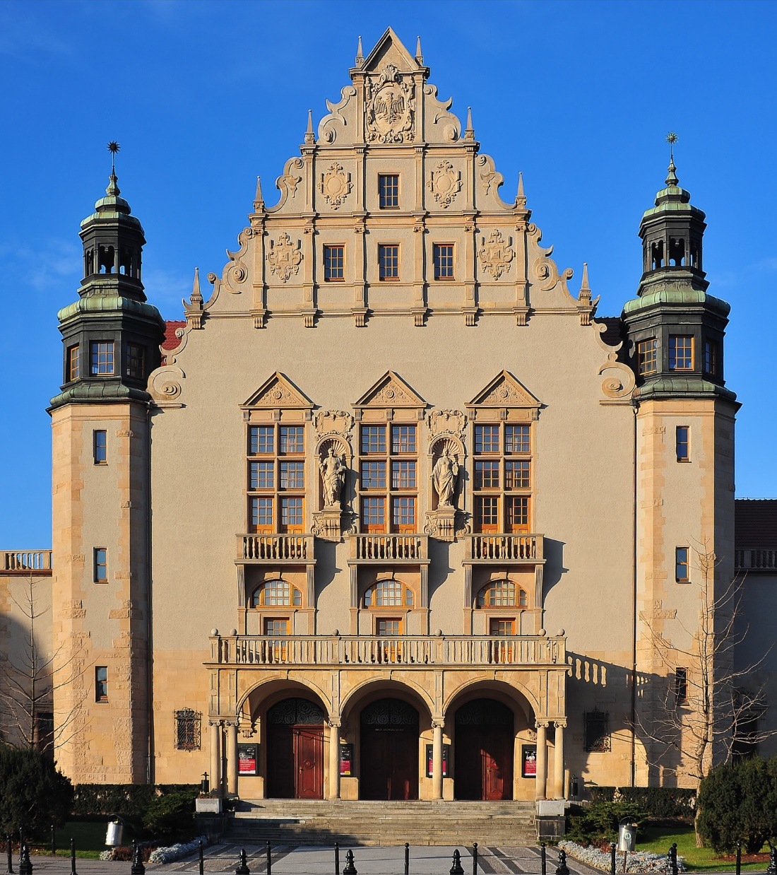


Slide 2
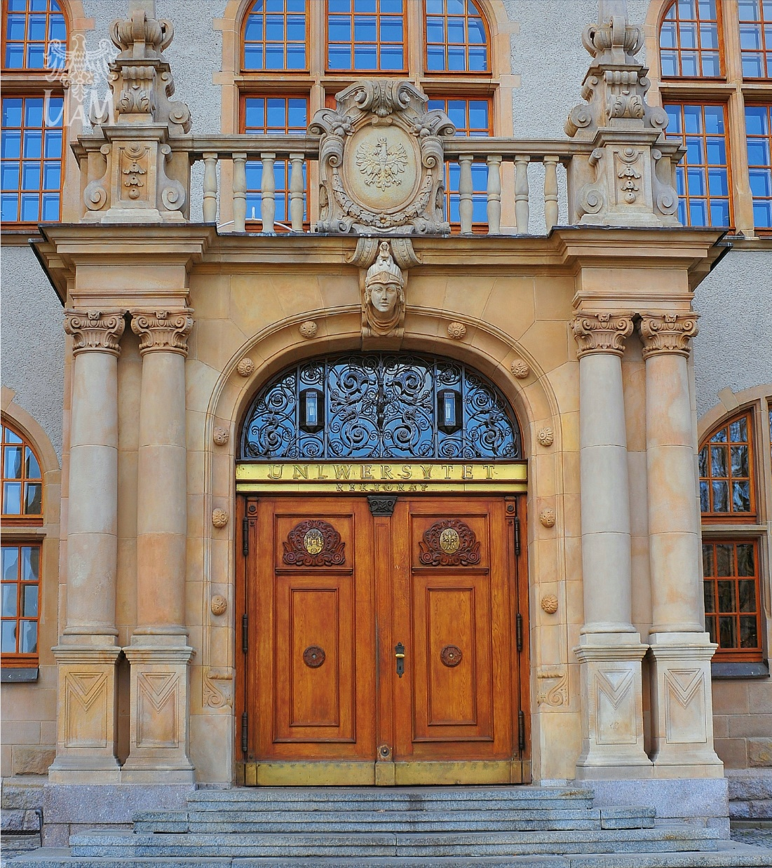
AMU in numbers
Faculties
Branches
Majors
Students
PH.D. students
Academic teachers
Administration staff
Partner universities
21
4
125
32100
1168
2852
2105
338

Slide 3

Where to find us

Slide 4

[Colourful University]

Slide 5
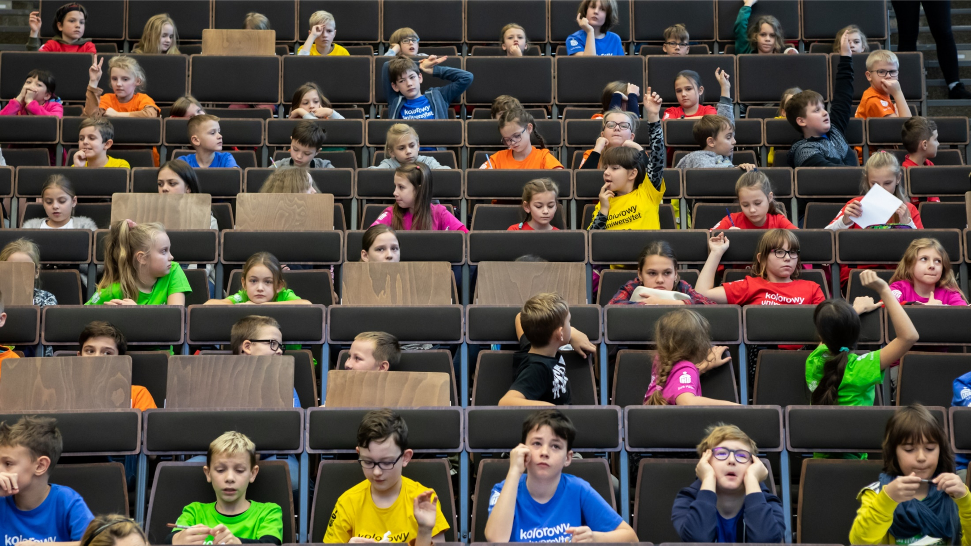

Slide 6
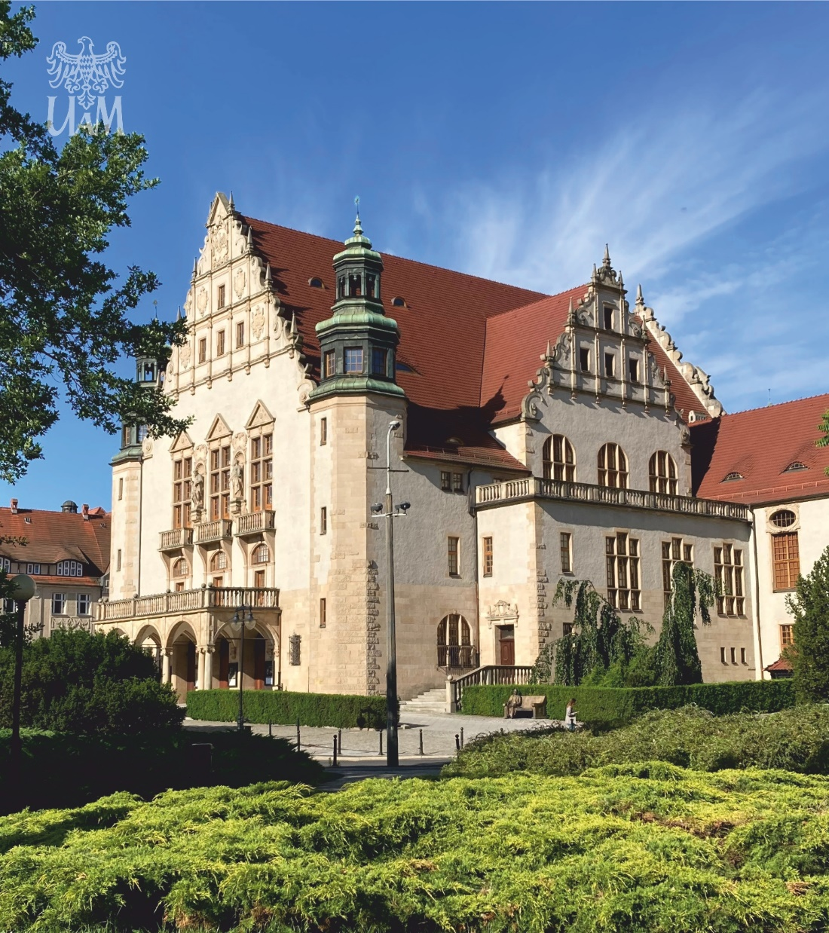
PROJECT IDEA:
AMU Colourful University is an initiative (qualified as the third mission) which aim is to popularize science and shows the university among primary school students
We’ve existed at AMU since 2010
AMU Colourful University is very popular in Wielkopolska region, and is a permanent event during the academic year

Slide 7


Slide 8

ORGANIZATION OF EVERY PROJECT YEAR:
Registration by our website: https://kolorowyuniwersytet.amu.edu.pl/ for groups, schools and individual students
Registration results and creating two lists of colourful students 7-9 years old and 10-12 years old (one group=150 children).
Priority is given to those who have not yet participated in project

Slide 9
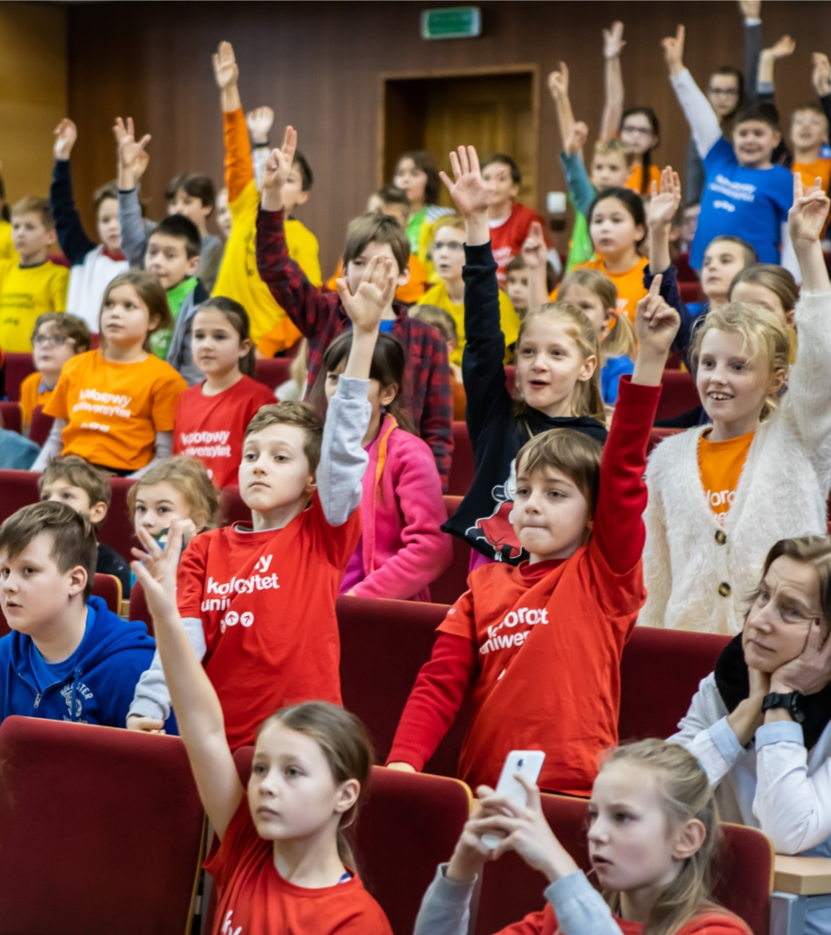
ORGANIZATION OF EVERY PROJECT YEAR:
Each group has its own schedule.
The classes are conducted by our
scientists (sometimes with cooperation with their students). They’re planned so that each group has its own once a month. We start in October and end in May.
We also have proposition for interested students – they can tell the audience about their passions, hobbies or interestsand feel like scientists.

Slide 10

ORGANIZATION OF EVERY PROJECT YEAR:
In June everybody (students and their families, scientist, students, faculty authorities, University authorities, representatives of our partners) meet in a historic hall at the ceremonial discharge and have their first graduation in life.

Slide 11
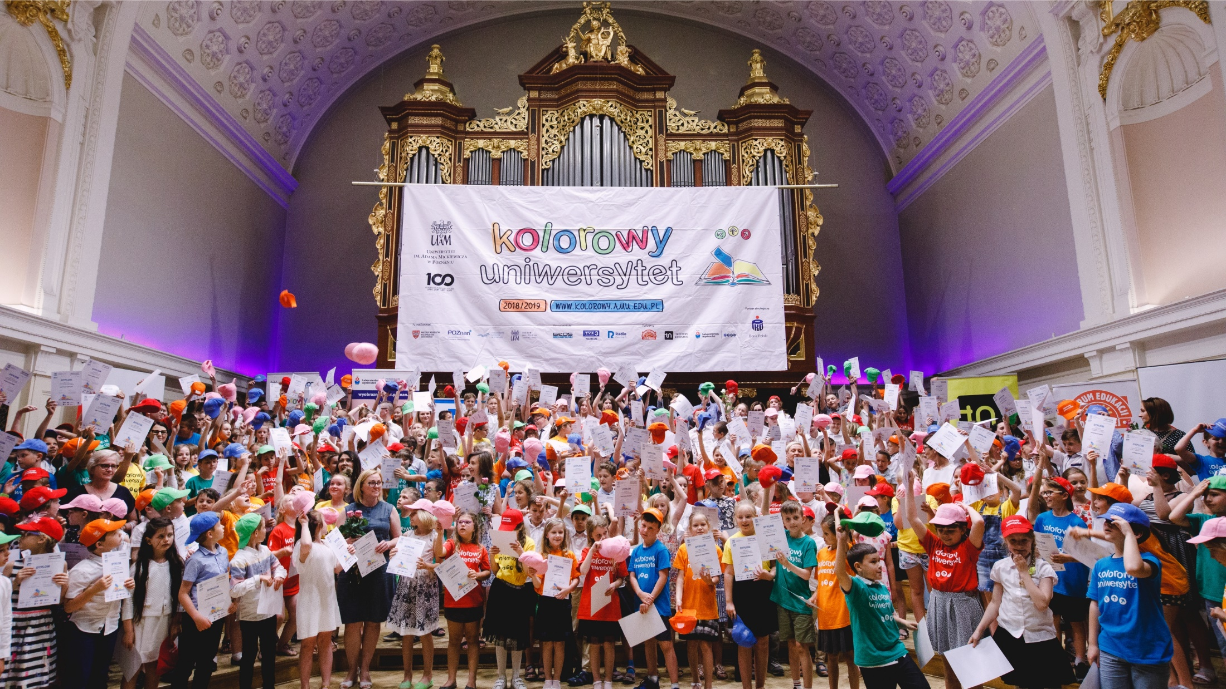

Slide 12
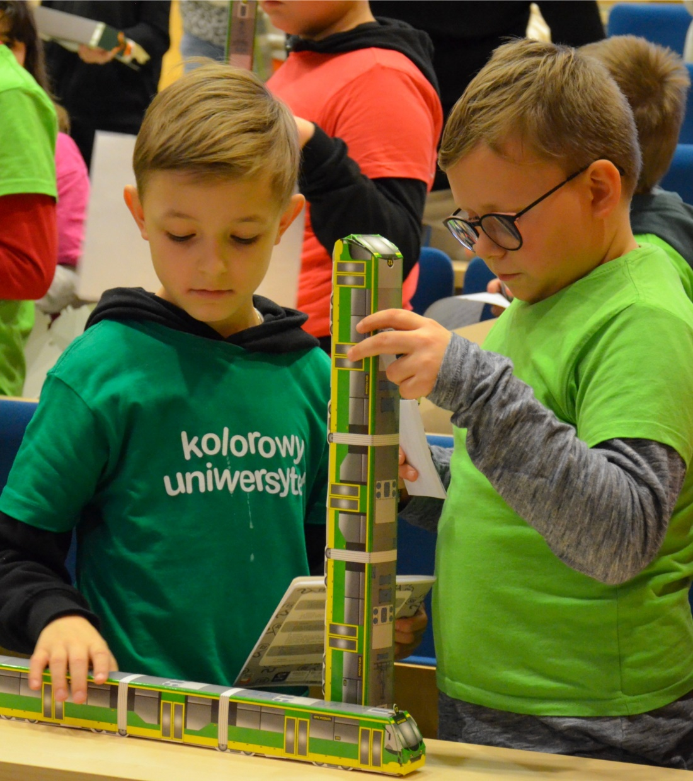
AMU Colourful University:
As you can see on photos our project is very colourful. Not only through various topics like: social, exact and natural sciences but also through colourful
T-shirts in which they come to classes.

Slide 13
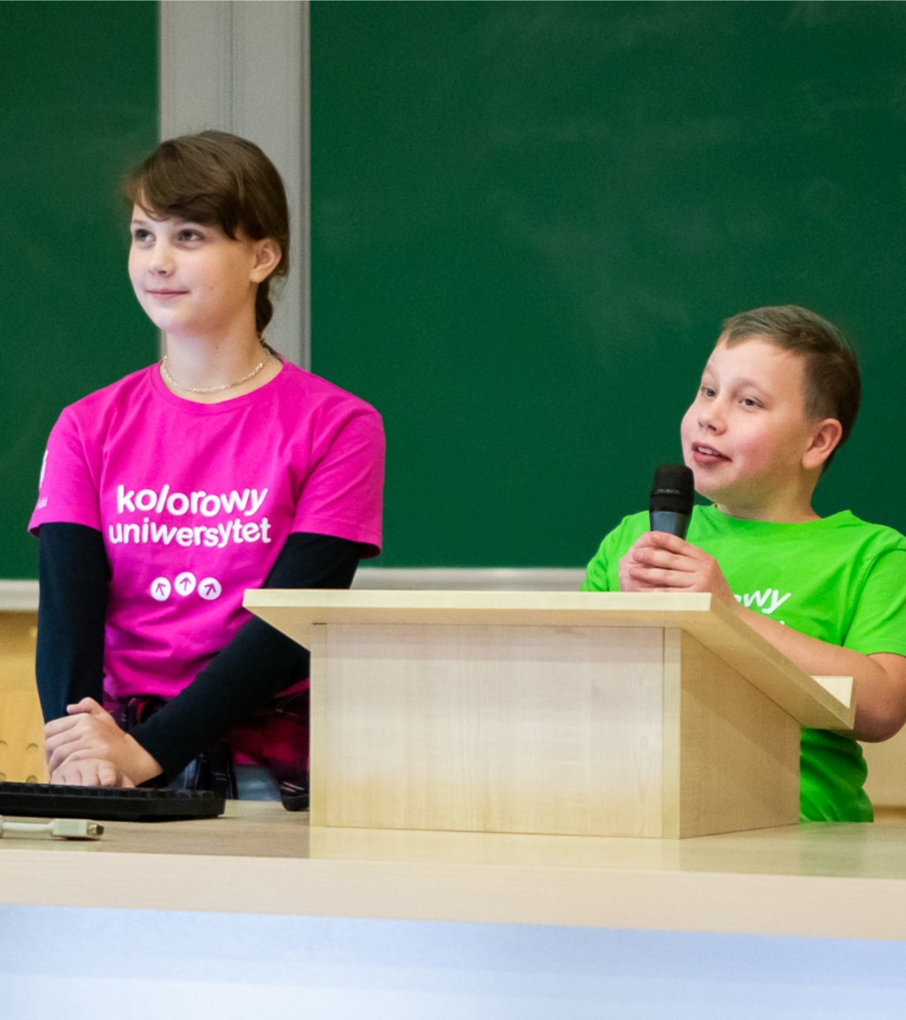
AMU Colourful University:
Details about the project you can find at our website: https://kolorowyuniwersytet.amu.edu.pl/
and www.facebook.com/KolorowyUAM

Slide 14
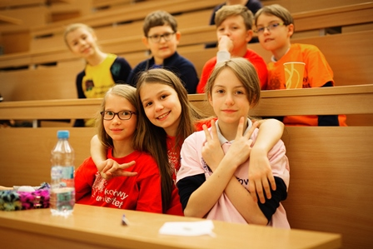

Thank you
This is our first time as a EUCU member and we’re very proud of it as Adam Mickiewicz University, Poznań.

Slide 15



Slide 16
Enjoy the film☺
Thank you for your attention.

