Slide 1
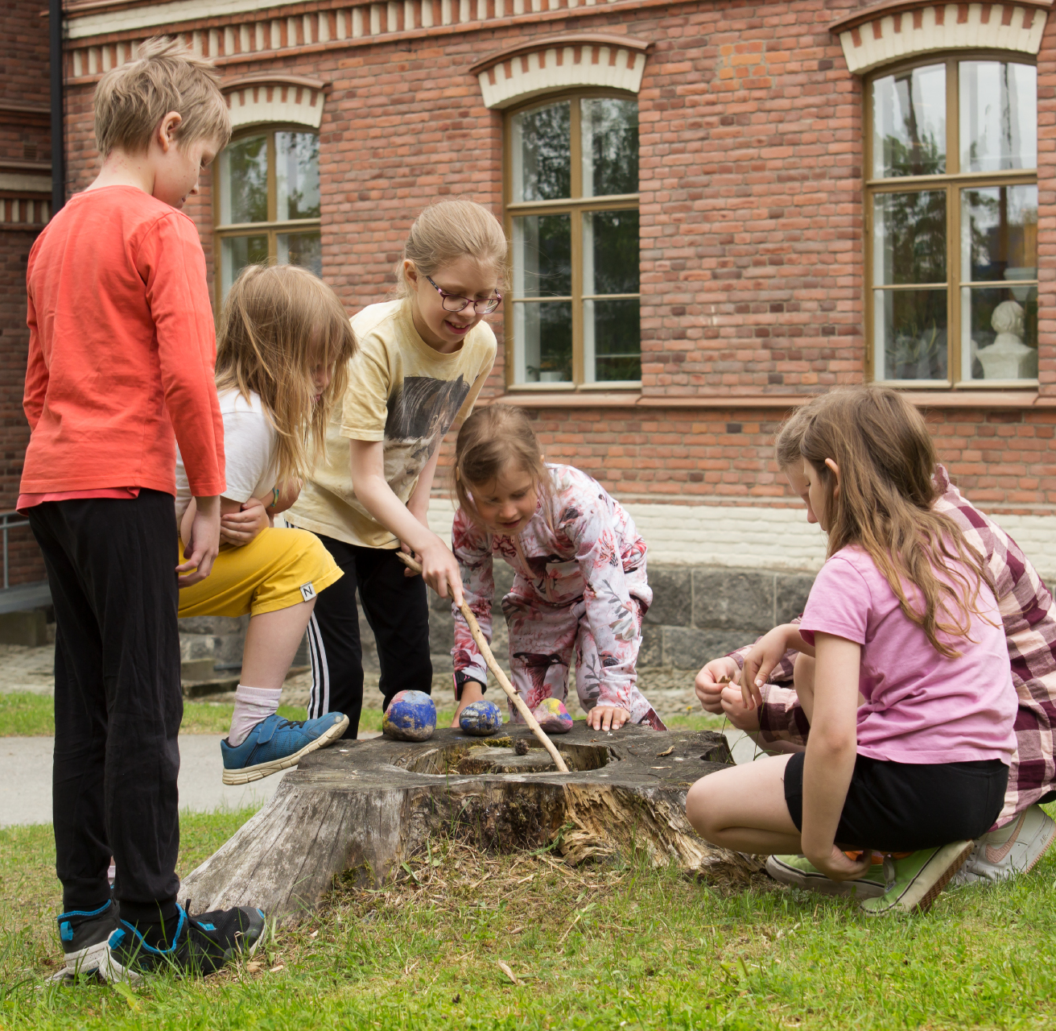

Children´s university
JYUniorit.
6.11.2023

Slide 2
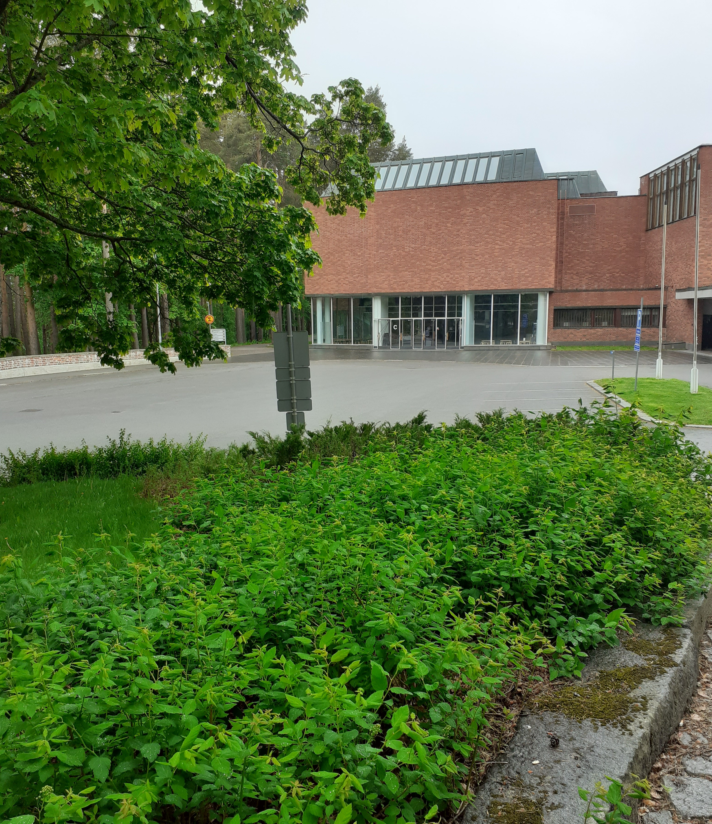
Co-operation in Science education
Jyväskylä University Museum offers guided tours and science education visits for school and daycare groups, delving into the secrets of nature, history, art and culture.
Summer University of Jyväskylä is a non-formal education association. In activities aimed at children, it offers leisure-time science clubs , workshops and camps.
Central Finland LUMA Centre promotes and supports schools and daycare in science education in natural sciences, mathematics, and technology.
Children's University 2014-2019 (Museum & Summer University)
JYUniorit Children's University since 2019 (all three together)

Slide 3
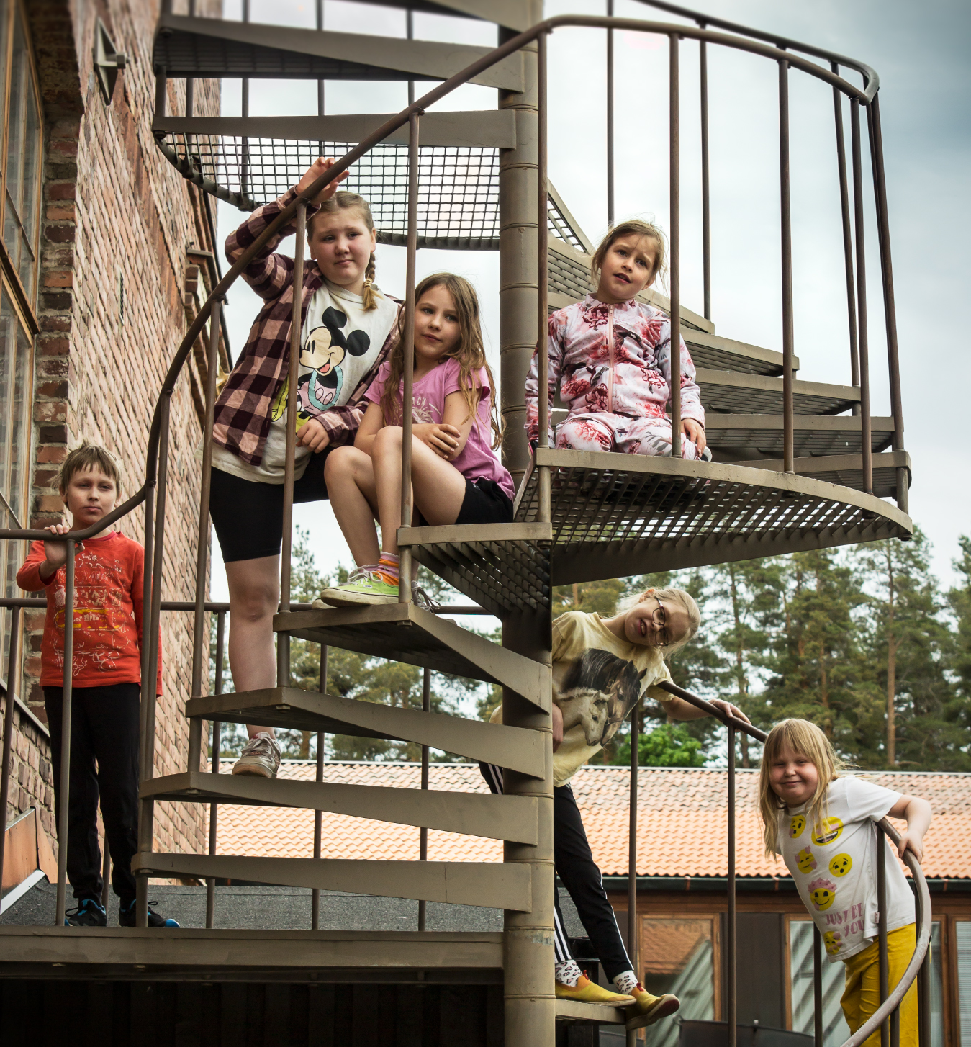
Children's University
JYUniorit.
Encouraging children and young people to explore the world of science.
Organizing science activities for daycare and school groups as well as for children and young people during their leisure time.
Inspiring children and young people to enter the world of science, art, and research through hands-on exploration and discovery.
Target group 3-18 years old children and youth.
Year 2022: 8600 patricipants, 60 university students.

Slide 4
Science for All since 2022
PLATFORM FOR POPULAR SCIENCE COMMUNICATION AND SCIENCE EDUCATION
JYUniorit
Teacher training
Science workshops and camps
Collaboration with schools and daycare centers
Research
Bublic events
Science events and fairs
Cultural events
Citizen science projects
Public lectures and seminars
University of the 3rd Age
Exhibitions
Jyväskylä University Museum: Natural History Museum and Soihtu Exhibition Center
Temporary exhibitions
Collections and archives
Collections and archives of the Open Science Center (Jyväskylä University Museum and University Library), archive of the National Audiovisual Institute
Visits and lectures
Events
Cultural and natural heritage events
Jyväskylä University Botanical Garden
Citizen science

Slide 5
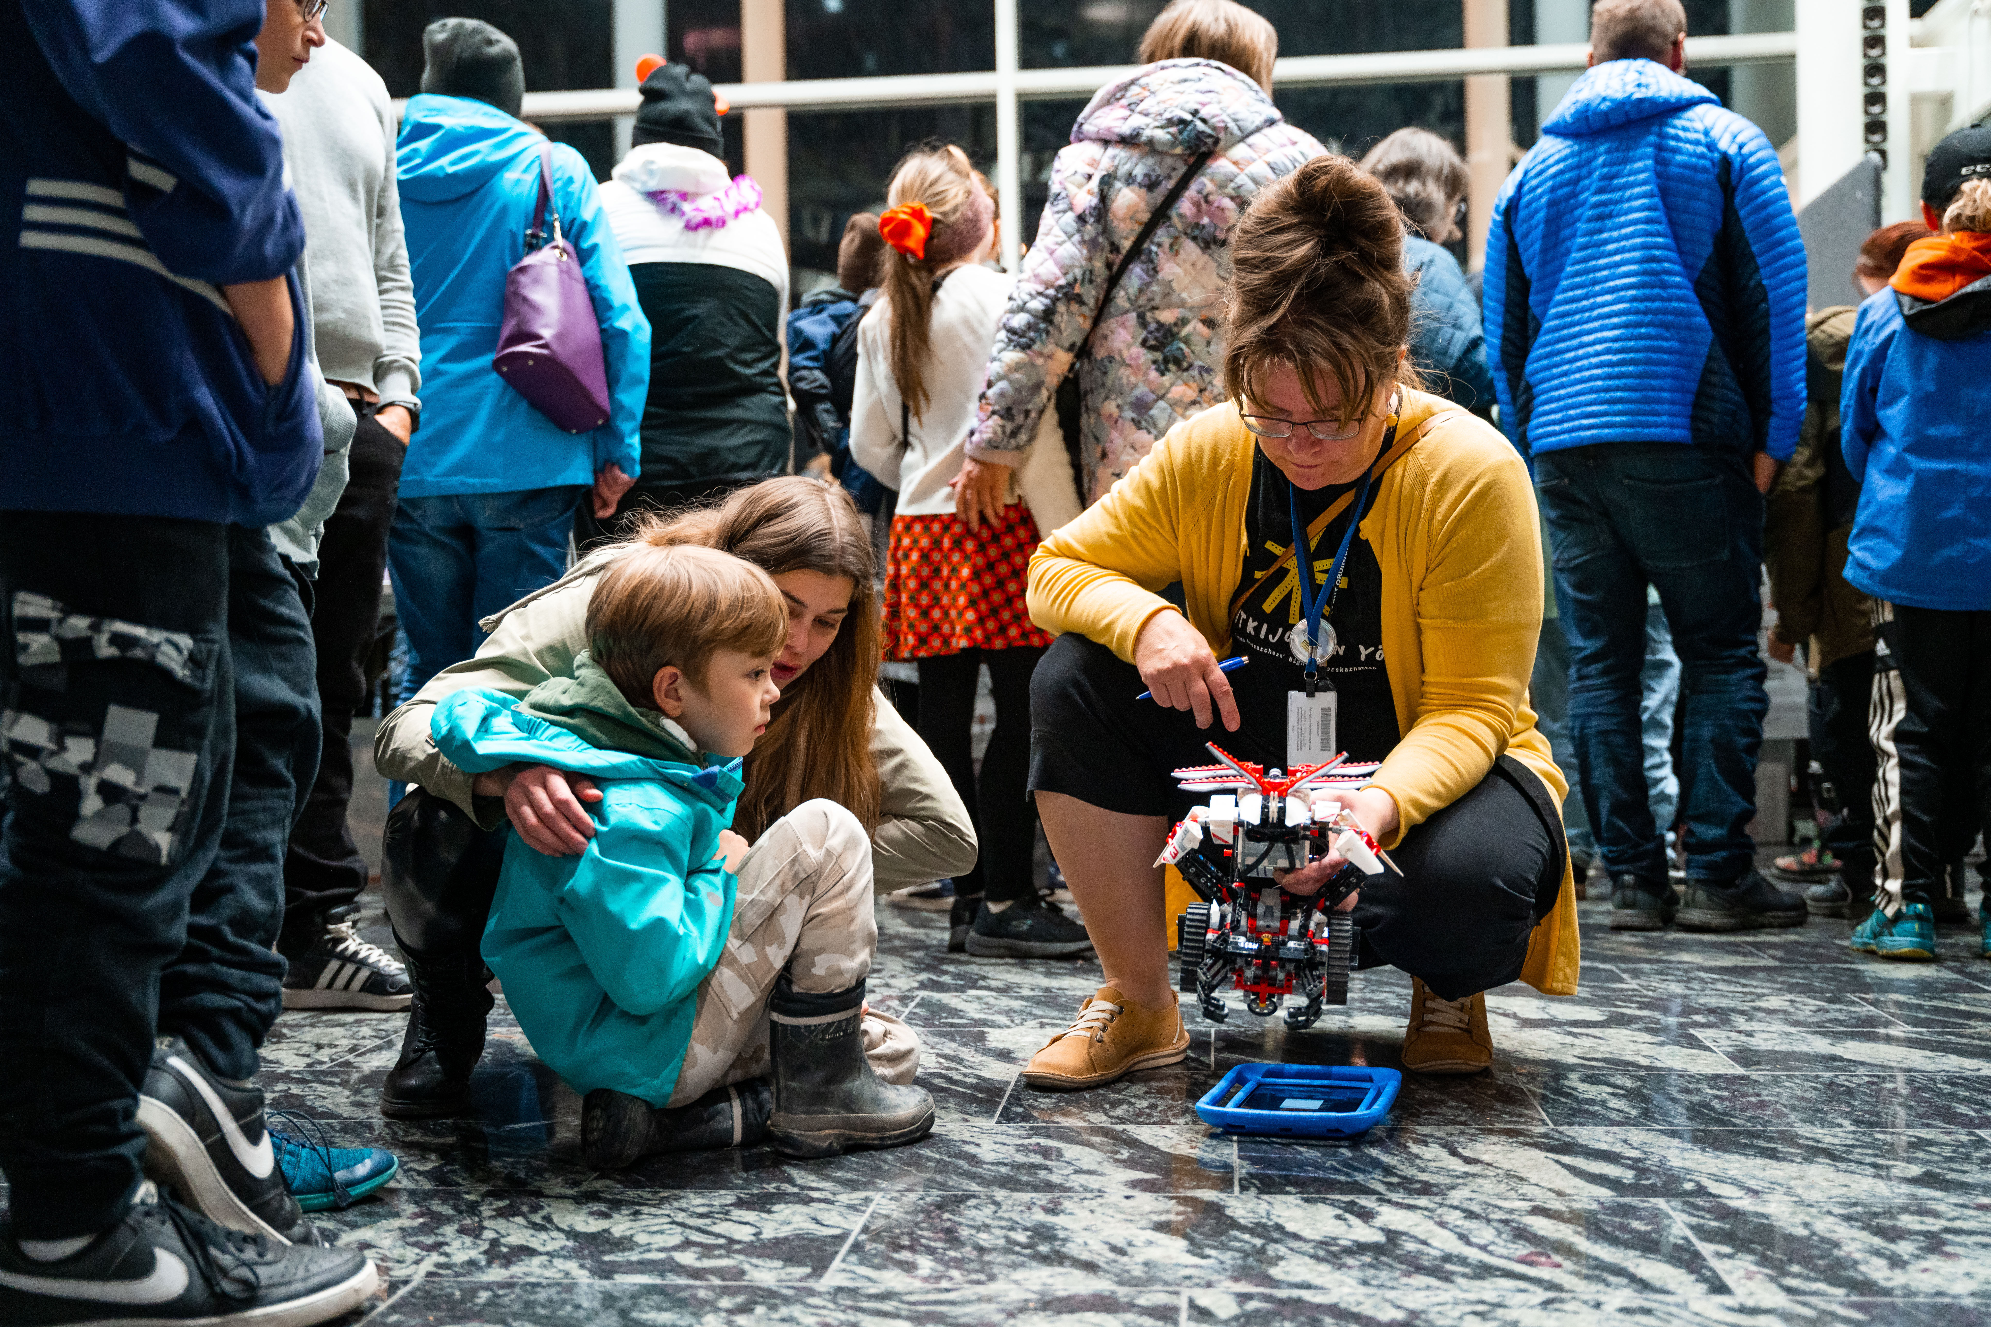

SCIENCE FOR ALL
PLATFORM for public events and services of University of Jyväskylä
OUTREACH ACTIVITIES for diverse audience
INSPIRE people of all ages to explore scientific knowledge through science events, workshops, exhibitions and services

Slide 6

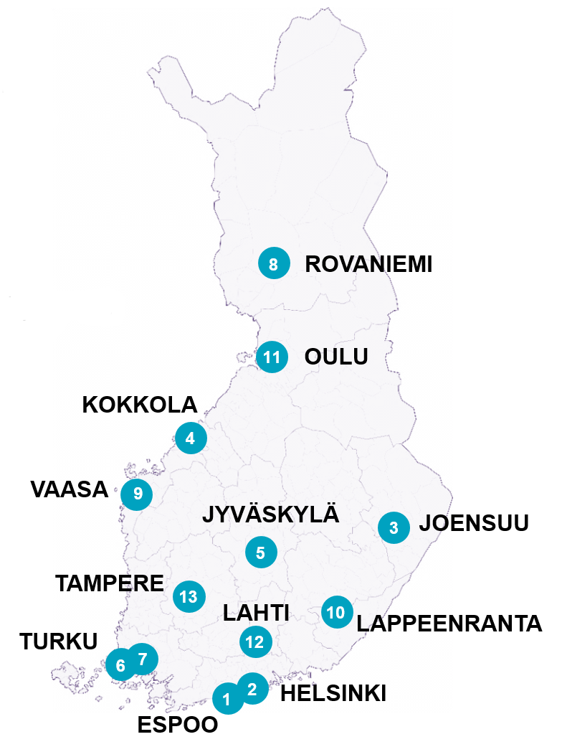
Regional LUMA Centres
Aalto University Junior
University of Helsinki Science Education
LUMA Centre of the University of Eastern Finland
LUMA Centre of Central Ostrobothnia (Kokkola University
Campus Chydenius)
Central Finland LUMA Centre (University of Jyväskylä)
LUMA Centre of Southwestern Finland (University of Turku)
Skolresurs (Åbo Akademi University)
LUMA Centre Lapland (Lapland University)
LUMA Centre of Ostrobothnia (University of Vaasa)
LUMA Centre Saimaa (LUT University and
LAB University of Applied Sciences)
LUMA Centre of the University of Oulu
LUMA Centre Päijänne Tavastia (Lahti University Campus)
Tampere University Juniversity
Notes:
LUMA Centre Finland has operated since 2013 as a network of 11 universities that specializes in science education. The aim of our operations is a high-level of knowledge in maths, science and technology and a sufficient number of LUMA professionals all over Finland.
LUMA Centre Finland inspires and encourages children and youth towards studying STEM subjects (math, environmental studies, science and technology,) and having these fields as hobbies through most novel science and technology education, supports teachers’ lifelong learning from early childhood education to the upper secondary level all over Finland, and strengthens research-based development work in teaching.
LUMA Centre Finland has a national task for the term 2021–2024 that was granted by the Finnish Ministry of Education and Culture. This national task ensures a good future for knowledge of LUMA fields and teacher education, and aims to strengthen Finland’s competitiveness. The funding is divided between the 13 LUMA Centres.

Slide 7
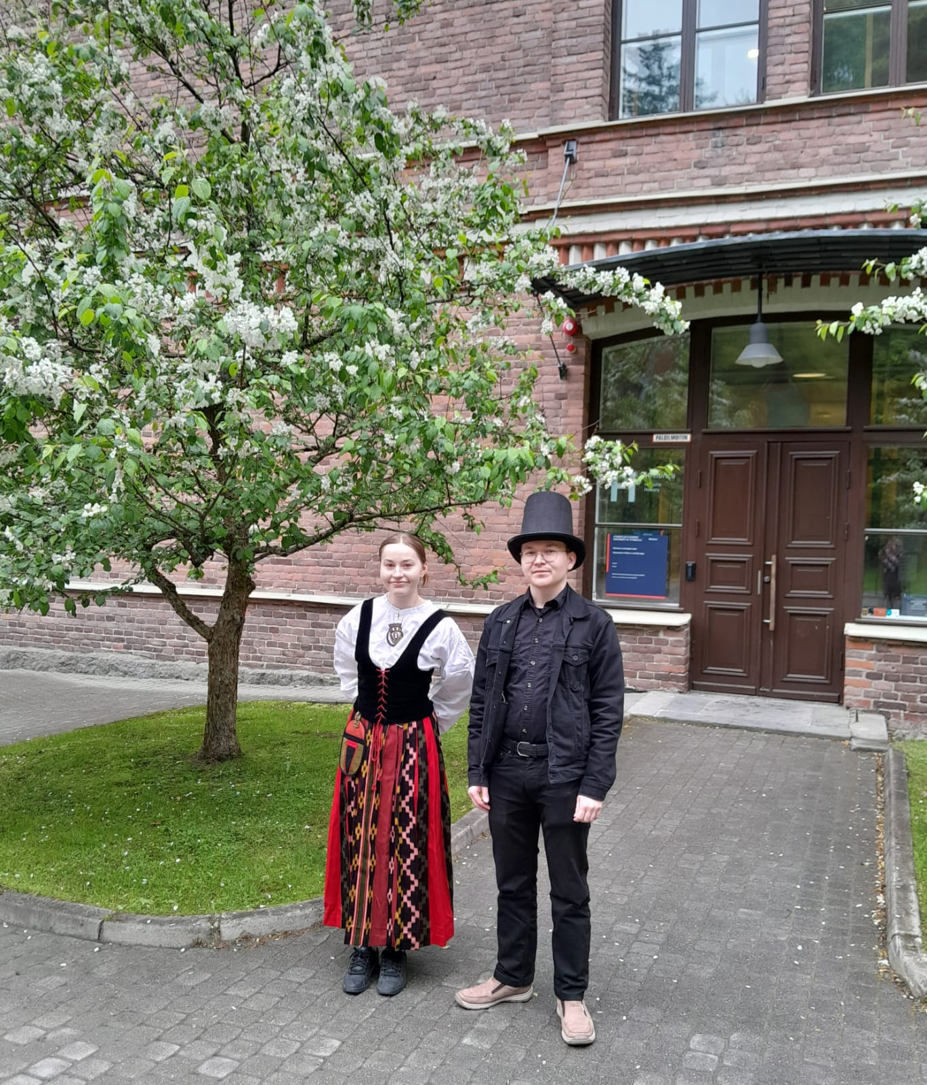
Co-operation with other actors
  University lecturers and researchers can use working hours for societal interactions.
  University students tutor leisure-time science clubs and camps as part of their studies and as paid work.
  Museum offers trainerships and part-time work for students.
  Co-operation with schools, cultural organisations, associations and municipalities (e.g. school visits,
  collective events)

Slide 8
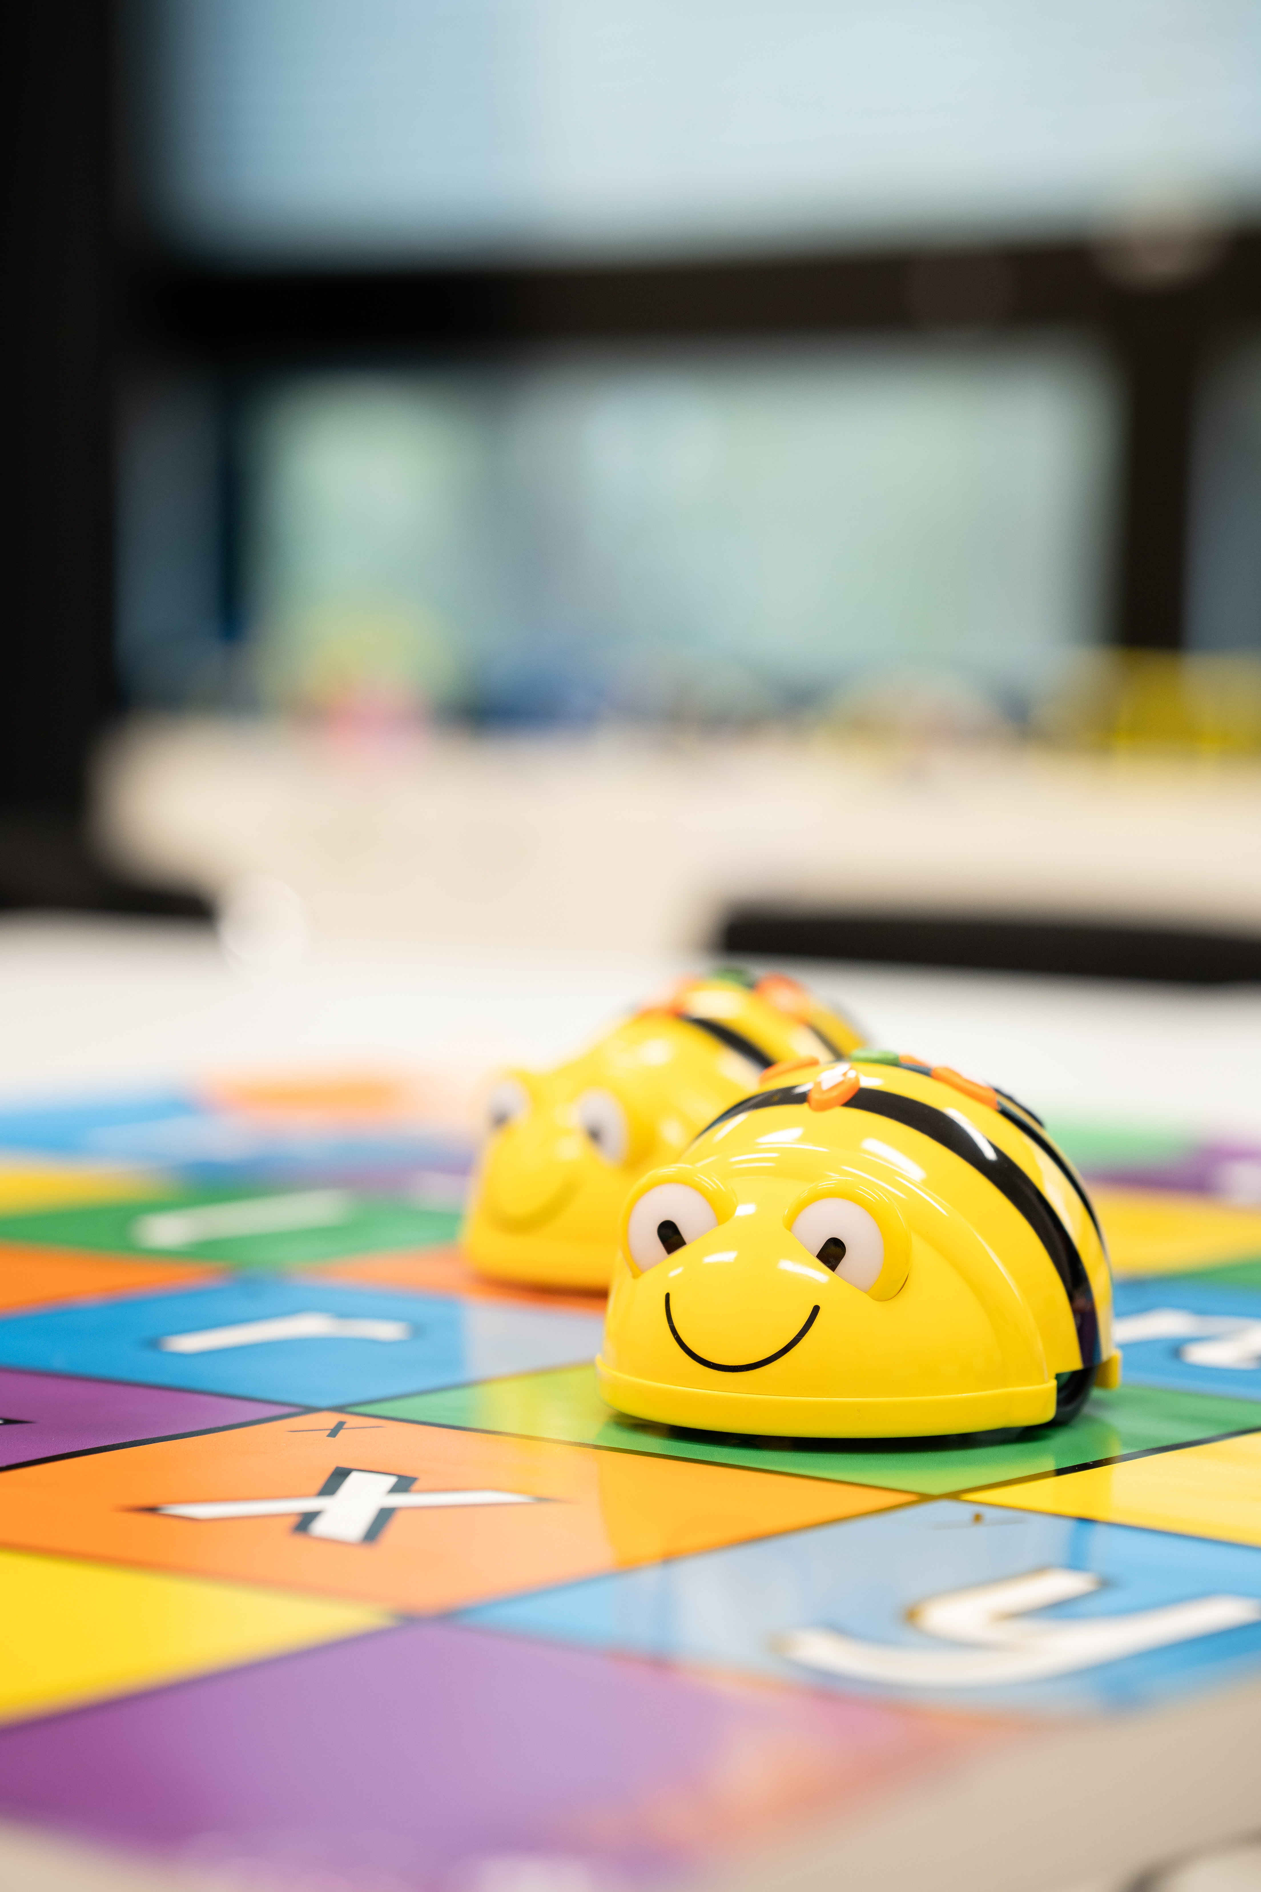
Activities
Experiential learning -learning through reflection on doing.
Multidisciplinary workshops, clubs and camps around the year.
Events e.g. Researchers' Night and City Festival.
LUMA-visits to schools (mathematics, science and technology).
In-service teacher training.
Teaching material.
Research (master's and bachelor's thesis).

Slide 9

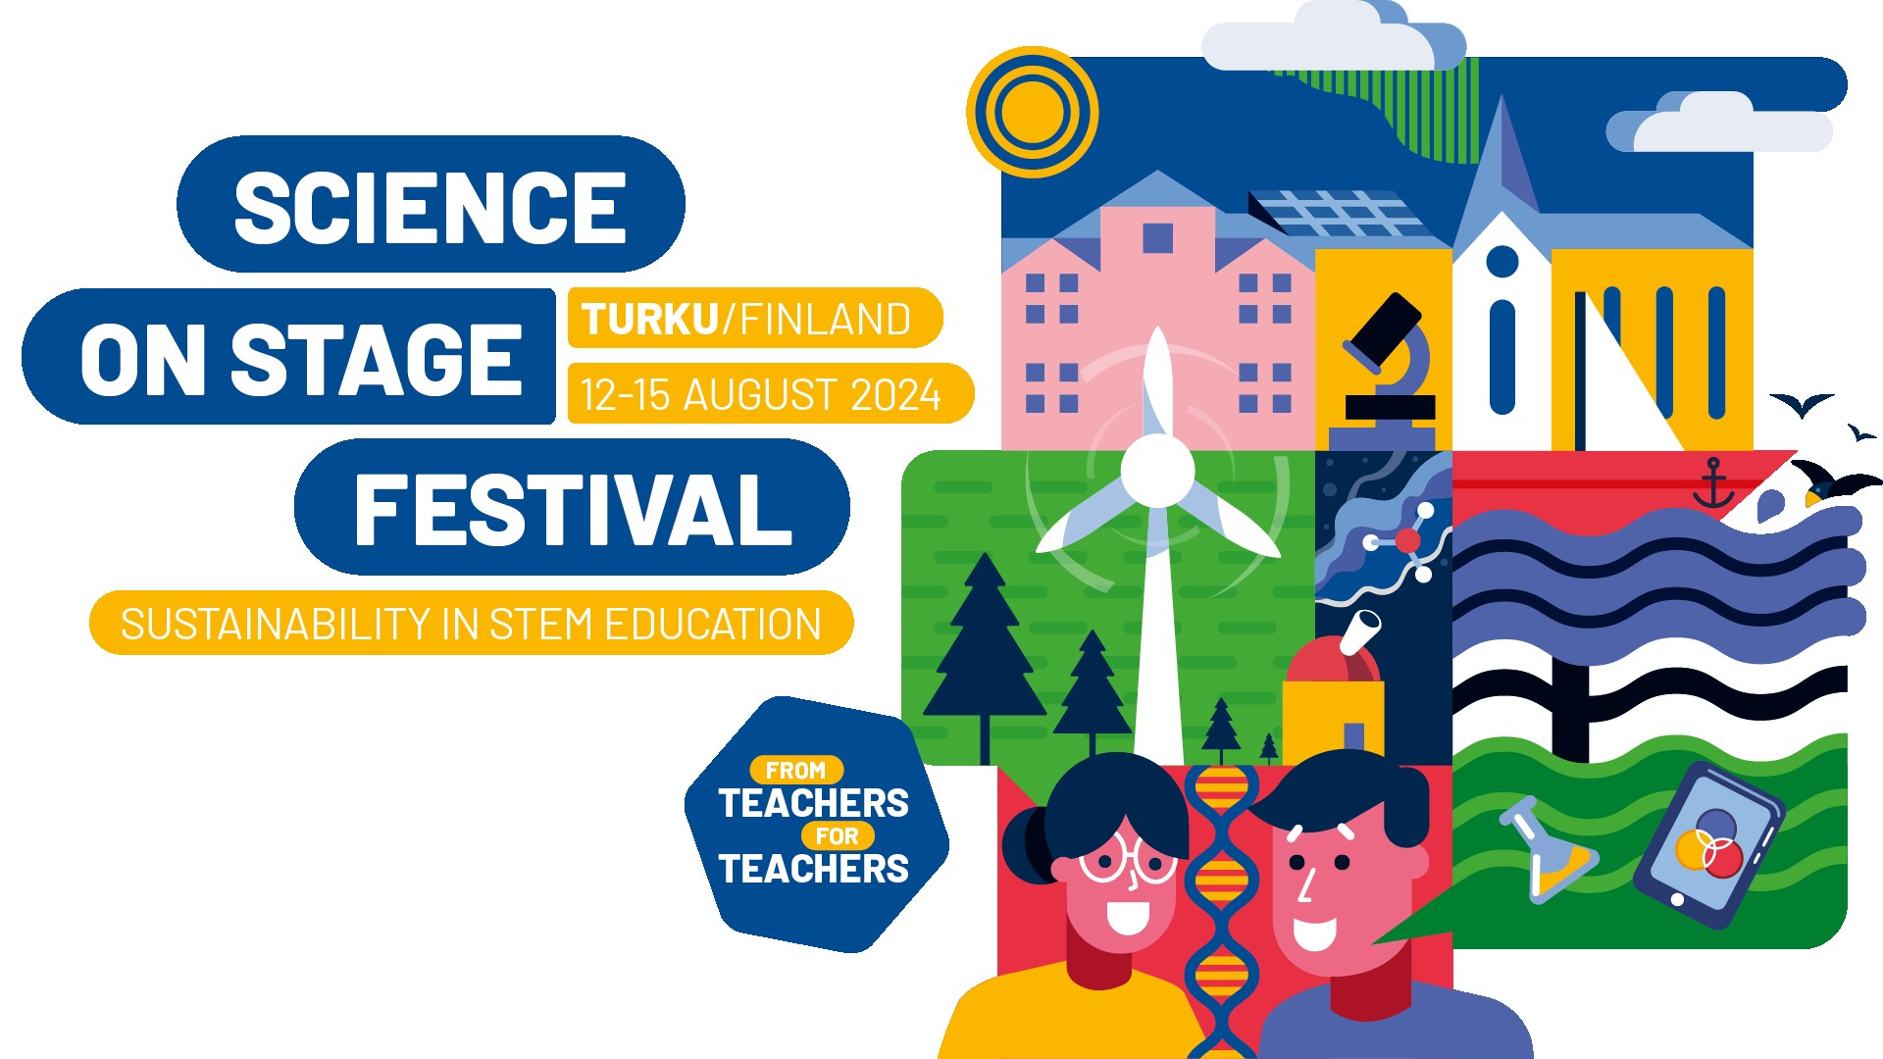
Science on Stage Festival 2024
Science on Stage festivals is Europe’s largest educational event for STEM teachers. The international fair aims to share ideas, learn new things, and get to know international colleagues.
The 13th European Science on Stage festival will take place from 12-15 August 2024 in Turku, Finland.
450 primary and secondary school teachers from all over Europe share their most creative STEM ideas at stands, in workshops, and in highlight sessions. Participants will be chosen through competitive national events in over 30 countries.

Slide 10
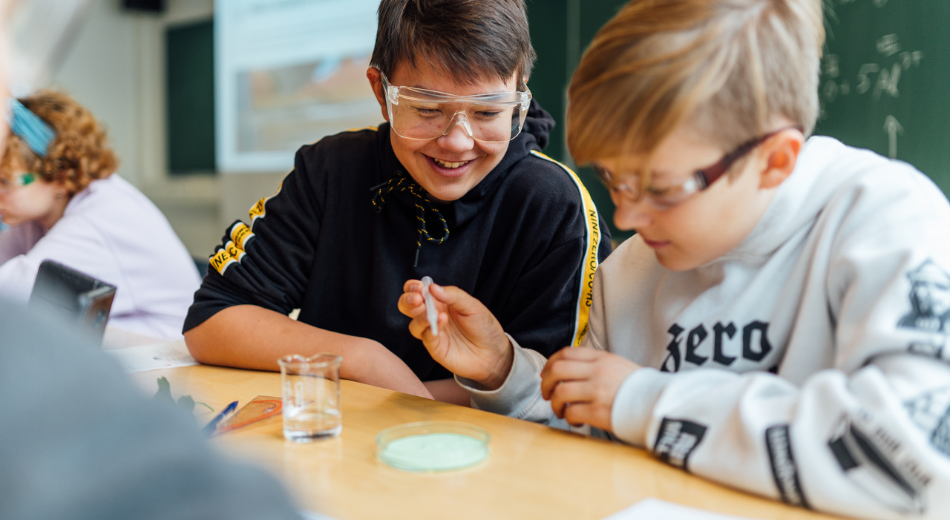




jyu.fi/en/childrens-university-jyuniorit
JYUniorit.
Jonna Timonen, Jyväskylä University Museum (JYUniorit) jonna.e.timonen@jyu.fi
Kristiina Niemi-Kaija, Jyväskylä Summer University (JYUniorit) kristiina.niemi-kaija@jyu.fi
Anniina Koliseva, Central Finland LUMA Centre (JYUniorit) anniina.koliseva@jyu.fi
Anni Aroluoma, Central Finland LUMA Centre (JYUniorit) anni.aroluoma@jyu.fi
Kati Karvonen, Jyväskylä University Museum (Science for All) kati.a.karvonen@jyu.fi

Slide 11

LUMA Centre Finland

Slide 12
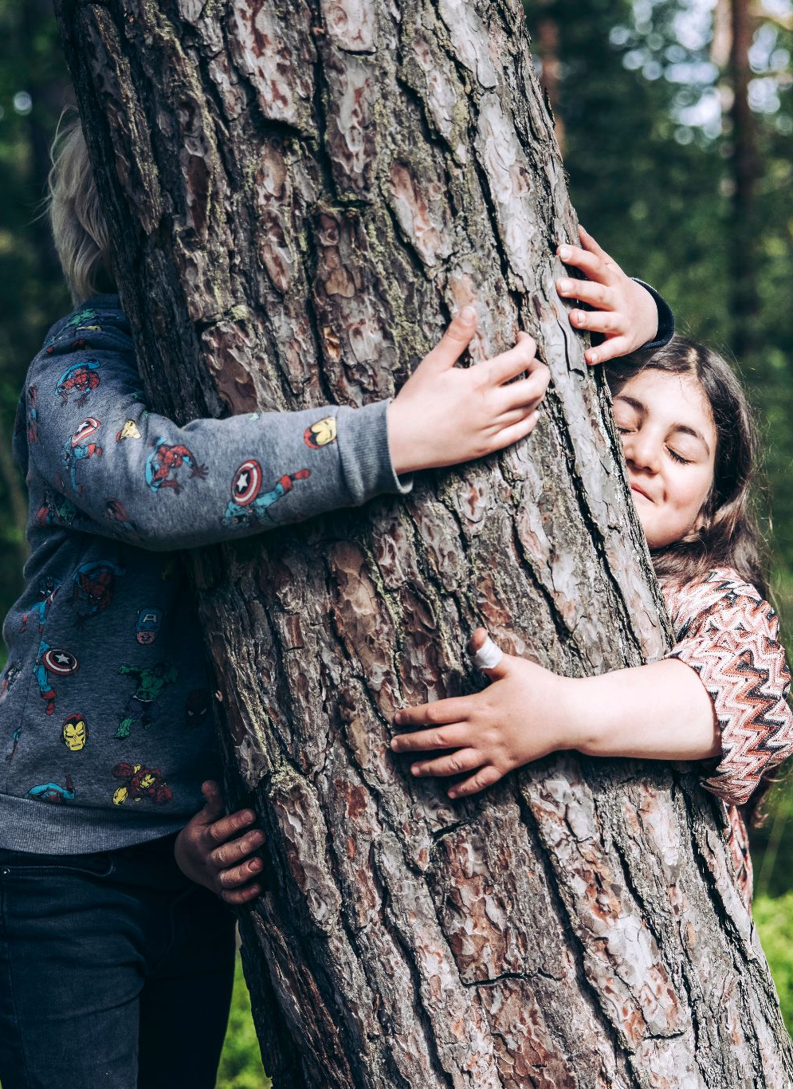
LUMA Centre Finland network
Has operated since 2013 as a network of 11 universities that specializes in science education
The aim of our operations is a high-level of knowledge in maths, science and technology and a sufficient number of LUMA professionals all over Finland.
Our focus is on LUMA subjects (= science, maths, technology and environmental studies) in a multidisciplinary way
Notes:
The Centre promotes knowledge of LUMA subjects in Finland through the common strategy (yhteisen strategiansa (pdf)). The aim of the operations is to secure the high-level of knowledge in maths, science and technology, and a sufficient number of professionals all over Finland.
The letter ”A” in the word LUMA can also refer to the multidisciplinary connection between these fields and all other subjects, or more specifically to arts.

Slide 13
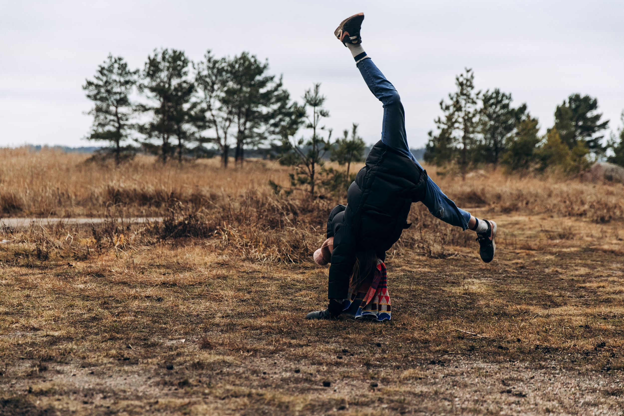


What does our network do?
We develop research-based solutions for teaching LUMA subjects
We support the work of teachers and their continuous professional development
We inspire children and youth towards studying these fields and having them as hobbies
Notes:
LUMA Centre Finland inspires and encourages children and youth towards studying math, environmental studies, science and technology, and having these fields as hobbies through most novel science and technology education, supports teachers’ lifelong learning from early childhood education to the upper secondary level all over Finland, and strengthens research-based development work in teaching.

Slide 14
The national task for the term 2021–2024
The Finnish Ministry of Education and Culture has granted funding for the network, and this funding is divided between the 13 LUMA Centres
The task is assessed based on the Centres’ annual aims, and self- and peer- assessment
Three areas:
Strengthening and broadening teachers’ continuous professional development.
Strengthening university collaboration and developing the network’s forums also for broader collaboration.
Increasing the accessibility and efficiency of the free-time LUMA activities.
Notes:
LUMA Centre Finland has a national task for the term 2021–2024 that was granted by the Finnish Ministry of Education and Culture. This national task ensures a good future for knowledge of LUMA fields and teacher education, and aims to strengthen Finland’s competitiveness. The funding is divided between the 13 LUMA Centres. The task is assessed based on the Centres’ annual aims, and self and peer assessment.
This term is already the second national task term for the network. During the term 2021–2024, the network’s internal collaboration is strengthened. In addition, the network has set three goals for itself that are adjusted through annual aims. These three goals can be viewed on the slides.

Slide 15
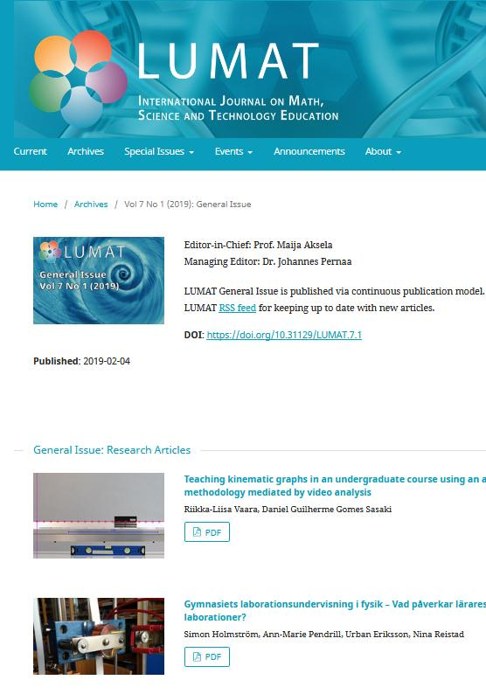
LUMAT publications
LUMAT is a peer-reviewed research journal that publishes both original articles as well as review articles.
LUMAT-B publishes compilation works from conferences and symposiums. The journal is suitable also for articles that are based on theses.
Notes:
LUMAT journals are scientific journals published by the LUMA Centre Finland and the University of Helsinki. LUMAT journals include two publications– LUMAT and LUMAT-B.
LUMAT publishes original research on science education related to math, science and technology. LUMAT-B publishes articles from the same fields of science, but it focuses on conference and symposium articles. LUMAT journals are read by researchers, but also by teachers and students. Also, the journals are used as course literature in subject teacher education.

Slide 16
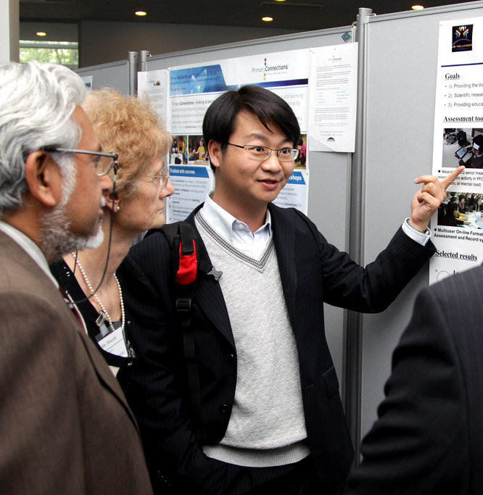
LUMAT Symposium
LUMAT Research Seminar
Symposium for math, science and technology teachers, teacher students, teacher educators, and researchers.
Free-of-charge event for everyone interested in teaching math, science and technology. Meetings are organized online a couple of times each year.
Notes:
The aim of the LUMAT Science Research Forum is to increase the quality, efficiency and visibility of the Finnish LUMA science education research. This is done by developing collaboration between universities, faculties and research groups, both nationally and internationally. The emphasis is on research regarding teacher education and on supporting lifelong learning. The forum has a national steering group. You are welcome to participate in our open science events!

Slide 17
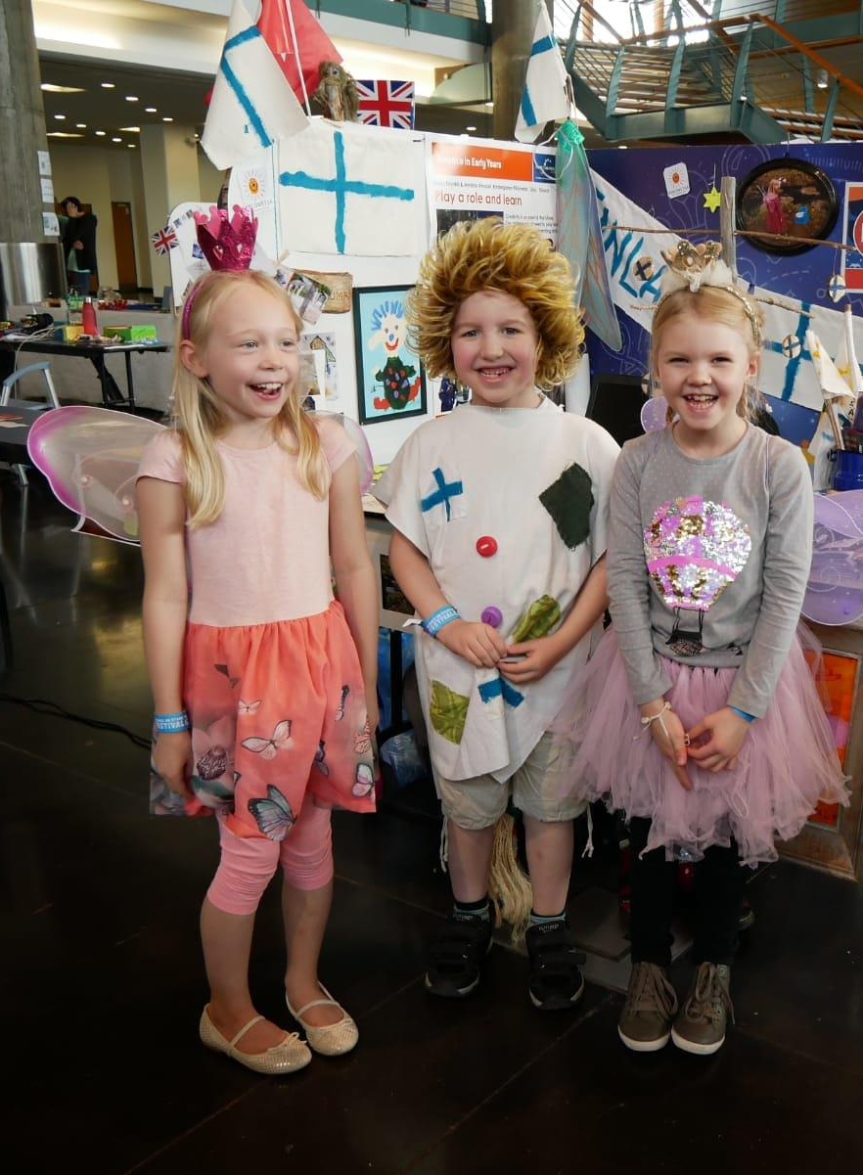

International collaboration
The Science on Stage network brings together STEM teachers from all around Europe to share their best practices.
The EU STEM Coalition network develops STEM teaching and advocates for their
significance in education
policy.
Notes:
The STEM Coalition is a wide-ranging collaborative organization, and its aim is to support education of LUMA subjects and educating oneself in Europe. At the same time, it aims to support the drafting and implementation of LUMA strategies in different countries, and shares good practices. The organization operates with funding from the EU and participates in the European community’s preparatory work regarding LUMA subjects as an advisory organization. LUMA Centre Finland is the organization’s associate member and represents Finland in the operations of the organization. Science on Stage (SonS) is an important partner of LUMA Centre Finland through the StarT program. The SonS festival is organized approximately every other year, and there teachers get to present their best teaching practices for science and technology education in an internationl forum for colleagues and researchers. The representatives of Finland for the festival are chosen as part of the international StarT program.
Children from Piilometsä kindergarten at the SonS festival in 2019.

