Slide 2
Lut Junior university
& uniori collaboration model
EUCUnet november 6th 2023, vienna
Annamaria Mustonen
Coordinator, Lappeenranta-Lahti University of Technology
Tel. +358 50 307 5942, annamaria.mustonen@lut.fi

Slide 4
LUT JUNIOR University activities
> 20 years of collaboration with schools and education providers
Science-based and building on strategic focus areas of LUT University
Science labs and classrooms, visits, workshops and themed days at the campus, school visits and visiting lectures, teacher training, free time activities (virtual or live science clubs and day camps, summertime activities) and much more!
Strong, curricula-based collaboration with educational institutions and other partners in Finland and abroad

Slide 5




LUT JUNIOR UNIVersity and sdgs
Through our JU activities, we focus on influencing the following UN´s sustainable development goals in particular:
Together with City of Lappeenranta, we have built a concept of collaboration that strengthens students' interest in mathematical and natural sciences and technology (STEAM) and provides students with comprehensive access to university education, thus promoting educational equality. The model has been introduced in other cities in Finland too.
As a part of our JU activities, we have developed study modules that focus on sustainable living and circular economy. Togerher with the school teachers, we have designed assignments where children share their new skills and knowledge with their families. This way we are able to reach not just the entire age group but gradually all the families in the partner cities.
We organize science-based training for school teachers in issues related to global warming. We support schools in their climate actions and offer knowledge and skills for children and youth about their possibilities to fight climate change. In all our actions, we create and maintain optimism and hope.
LUT Junior University is building on strong collaboration and partnerships with education providers, schools, companies, NGO’s and other institutions in all levels of educational system in Finland and abroad. We have strongly contributed to the European Green Leaf Award of the City of Lappeenta and continue developing new, European and global partnerships for more sustainable future.

Slide 6
In Lappeenranta
Every child gets involved in Junior University activities
Annually: ~ 3000 pupils in preschools and basic education, ~1000 high school students
All learning activities are included in curricula.
Close cooperation with teachers, also educating the teachers whose classes are involved,
Greenreality goals and activities of the city: involving and engaging children and youth
  https://www.greenreality.fi/en
Co-operation with various partners (including companies, NGO’s, city officials…)
Continuous and systematic concept, not based only on projects or personal interests of teachers or principals.
Based on strategic key research areas of LUT University

Slide 7




Collaboration with education providers
Close collaboration with several Finnish towns and cities, active partners in their educational models for STEAM, sustainability and entrepreneurial education: Uniori – Lappeenranta, JunnuYliopisto – Lahti, Universoma – Imatra, Tiedepolku – Mikkeli…

Slide 8
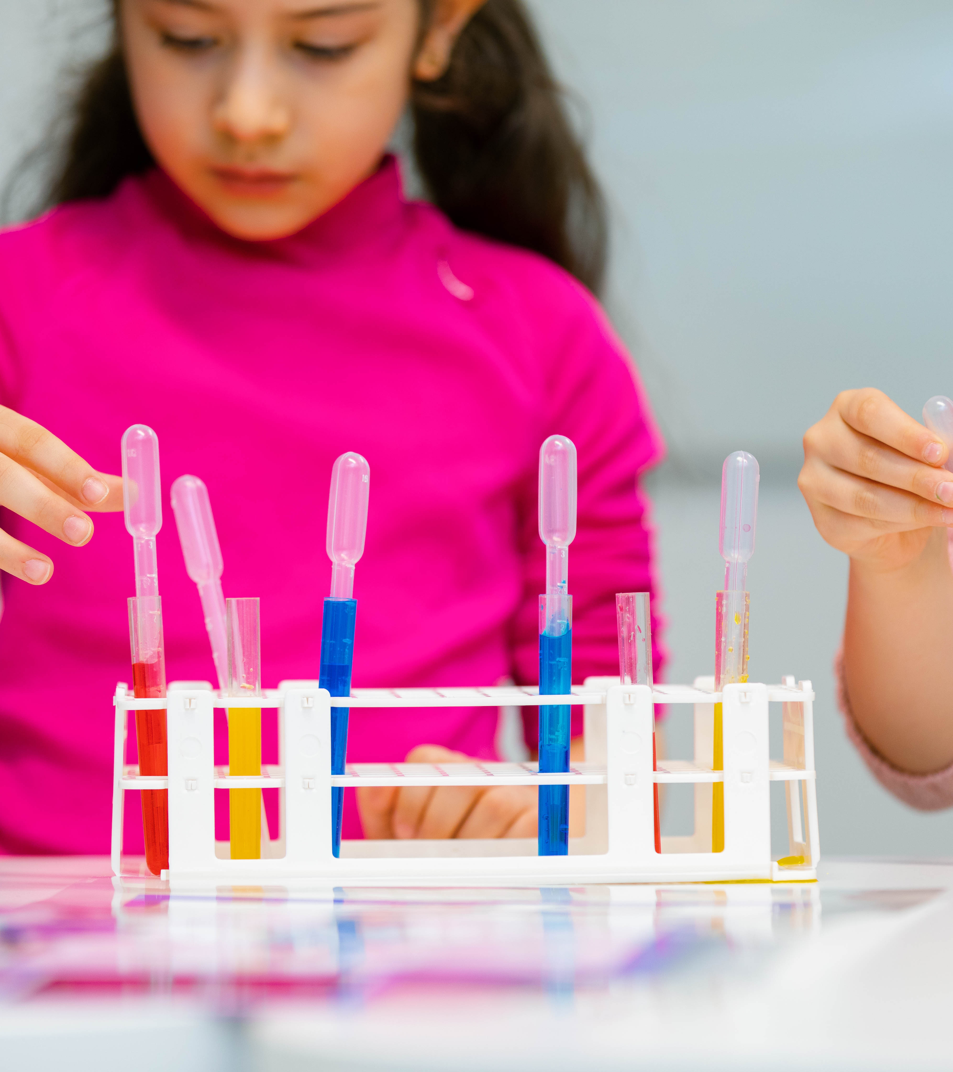
Lappeenranta Junior University -UNIORI
In 2017, new concept of cooperation with City of Lappeenranta – Lappeenranta Junior University
Together we are building an equal, continuous and systematic path to university studies for every child in Lappeenranta, giving them the best knowledge and skills for academic studies in Finland and awakening their interest in science, technology, research and sustainable business

Slide 9
To Whom? What? How?
Preschool | Clean Energy, Clean Water, Circular Economy | Various learning and teaching materials: stories, music, games, research instruments, EcoDetective-materials.
3rd grade | Clean Water, Circular Economy | Specialist-driven themed days at school (“The Water Days”) Plenty of various teaching and learning materials.
5th grade | Sustainable Business, Entrepreneurship | Teaching materials, entrepreneurial event at LUT campus (one schoolday).
8th grade | Sustainable Living (incl. Clean Energy, Clean Water, Clean Air, Circular Economy, Sustainable Business and Entrepreneurship) | Interdisciplinary learning module, workshop day at LUT campus.
High school | Clean Energy, Clean Water, Clean Air, Circular Economy, Sustainable Business and Entrepreneurship | Lectures, intensive days, university courses, collaboration courses, workshops campus visits, internationalisation at home, science programs

Slide 10
Our top five lessons learned
1) Strong and committed collaboration between university and education provider on every organizational level are a key to success.
2) Resourcing matters. We have gained results because we have had working hours and working hands for making those results.
3) Developing new concepts takes time. In our case, 3-5 years.
4) It is important to keep up good working spirit, good humor and good mood.
5) Never underestimate the potential that lies in every child!

Slide 11
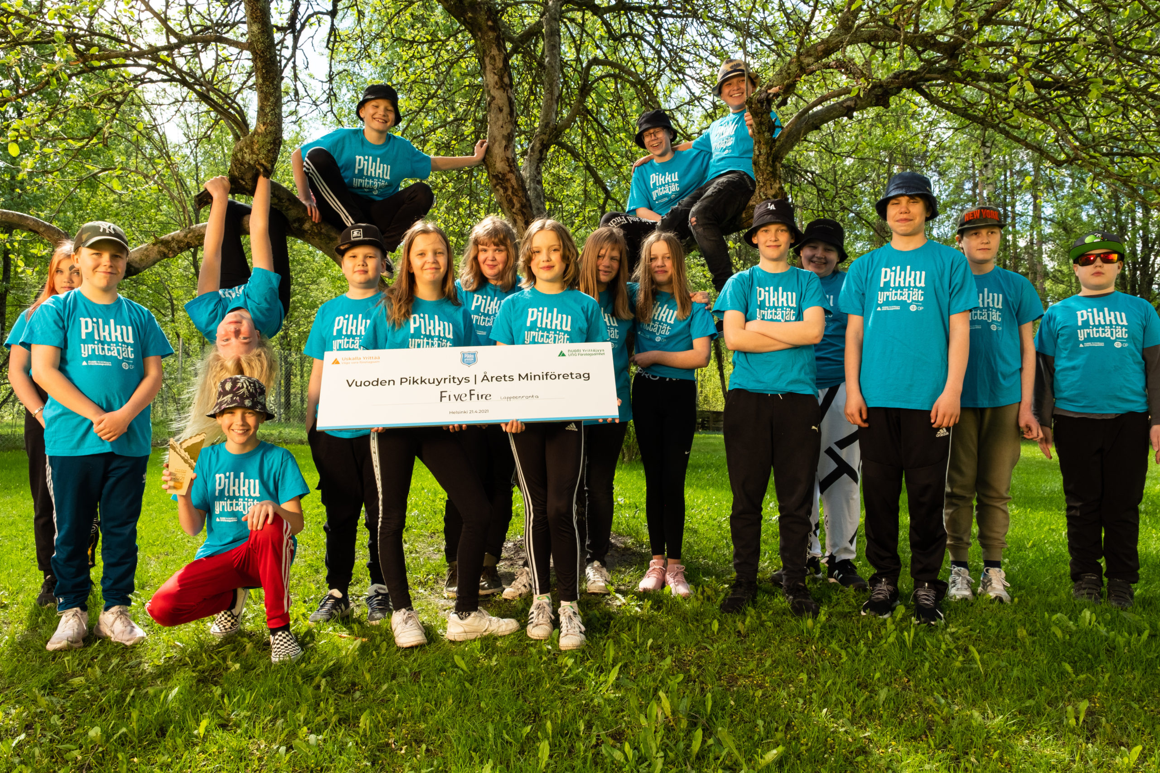

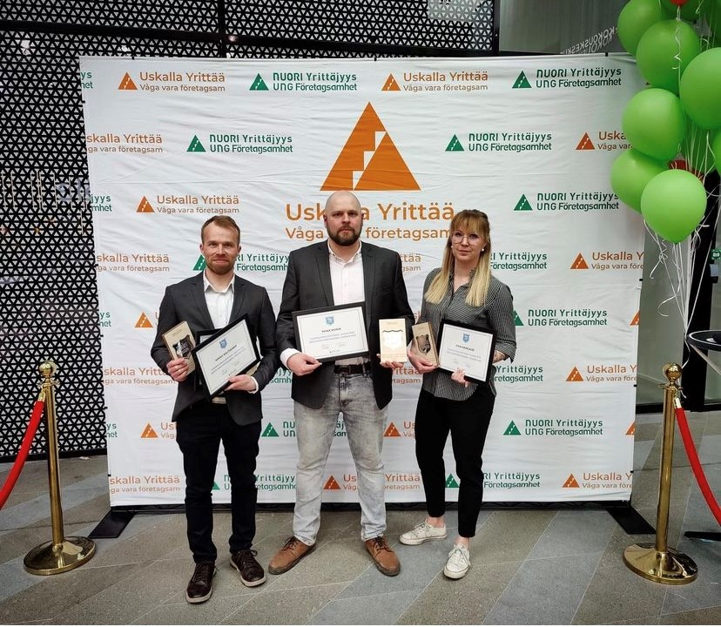
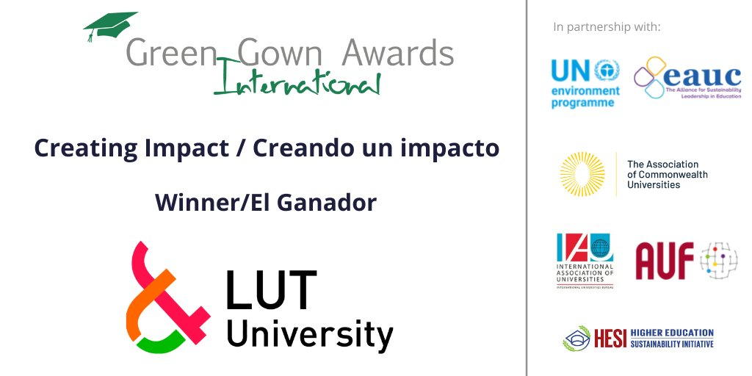
International Sustainable Campus Network
“Partnership for Progress” award in 2020
Notes:
Palkinnot: International Sustainable Campus Network Partnership for Progress, 2020
International Green Gown Awards Winner in Creating Impact category, 2021
Vuoden paras Pikkuyritys Lappeenrannan Pulpin koulun Five Fire 2021
Vuoden Pikkuyrittäjät-kummit: Uniorin LUTra-tiimi 2022 (lappeenrantalaiset luokanopettajat Topias Haarala, Jenni Kainlauri, Miika Miinin ja Mikko Rautiainen)

Slide 12
More information? Ideas for international cooperation? Please be in touch!
Annamaria Mustonen, MSc (Tech.), Coordinator of LUT Junior University
annamaria.mustonen@lut.fi, +358503075942
https://www.lut.fi/en/studies/junior-university
https://www.uniori.fi/in-english/
https://www.youtube.com/watch?v=rBm6xwh7TJ8&list=PLr3KgO4XzwEXO47JShqvv-p1Z1H1sEh1z&index=2

