Slide 1
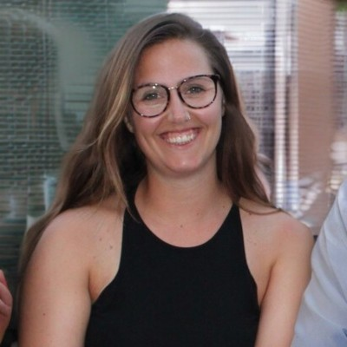
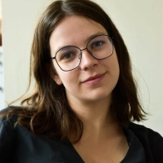
Children’s universities in an urban context
SAMMY
FRAN
How to attract a
diverse audience?
Notes:
Our last online meeting
Difficulties to reach a diverse audience → need for tools to attract a diverse audience

Slide 2



We focus on three aspects
Class setting
(not in free time)
Flexibility
Date, location, duration
Free of charge
Funding +
VUB investment
Notes:
The first one is our class setting. We only work with classes and teachers. None of our activities are during the free time of the children. Targetting individual children is quite difficult, time consuming and attendance is uncertain. You only reach a small section of your target audience.
All our activities are in class setting. They take place from Monday to Friday between school hours.
We want to make sure that our workshops are approachable without any restrictions. That is also why we are flexible with both timing and location for our workshops.
Our researchers do this as an extra in their free time. They don’t get paid for their engagement in the children’s university. → part of their social responsibility
All our activities are free of charge to make them as accessible as possible.

Slide 3
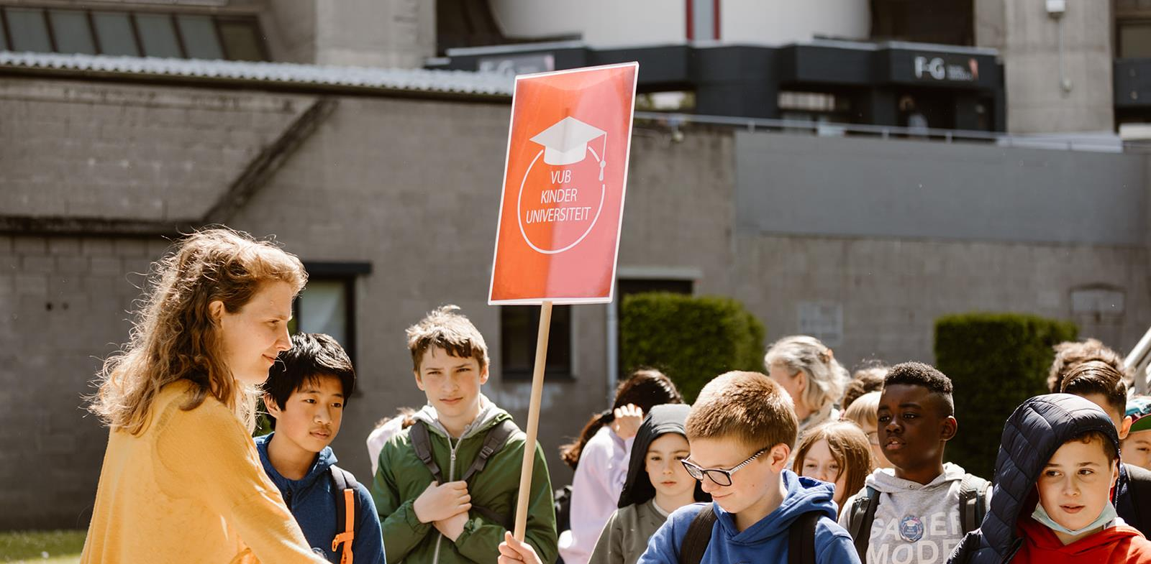

CLASS SETTING
?
WHO’S RESPONSIBLE
AND WHY
Notes:
By shifting the responsibility of registration from parents to teachers, you reach more children and cover a bigger part of your target audience. We organise all our activities from Monday to Friday between school hours.
Parents don’t have to register for their children to learn more about science. As already said week-ends are quite busy and parents often have to work or also tend to their other responsibilities or children.
We reach many children in class setting, which is also a known and often comfortable environment for the pupils.
Our researchers know how many and which children attend their workshop and often give it a personal touch.

Slide 4
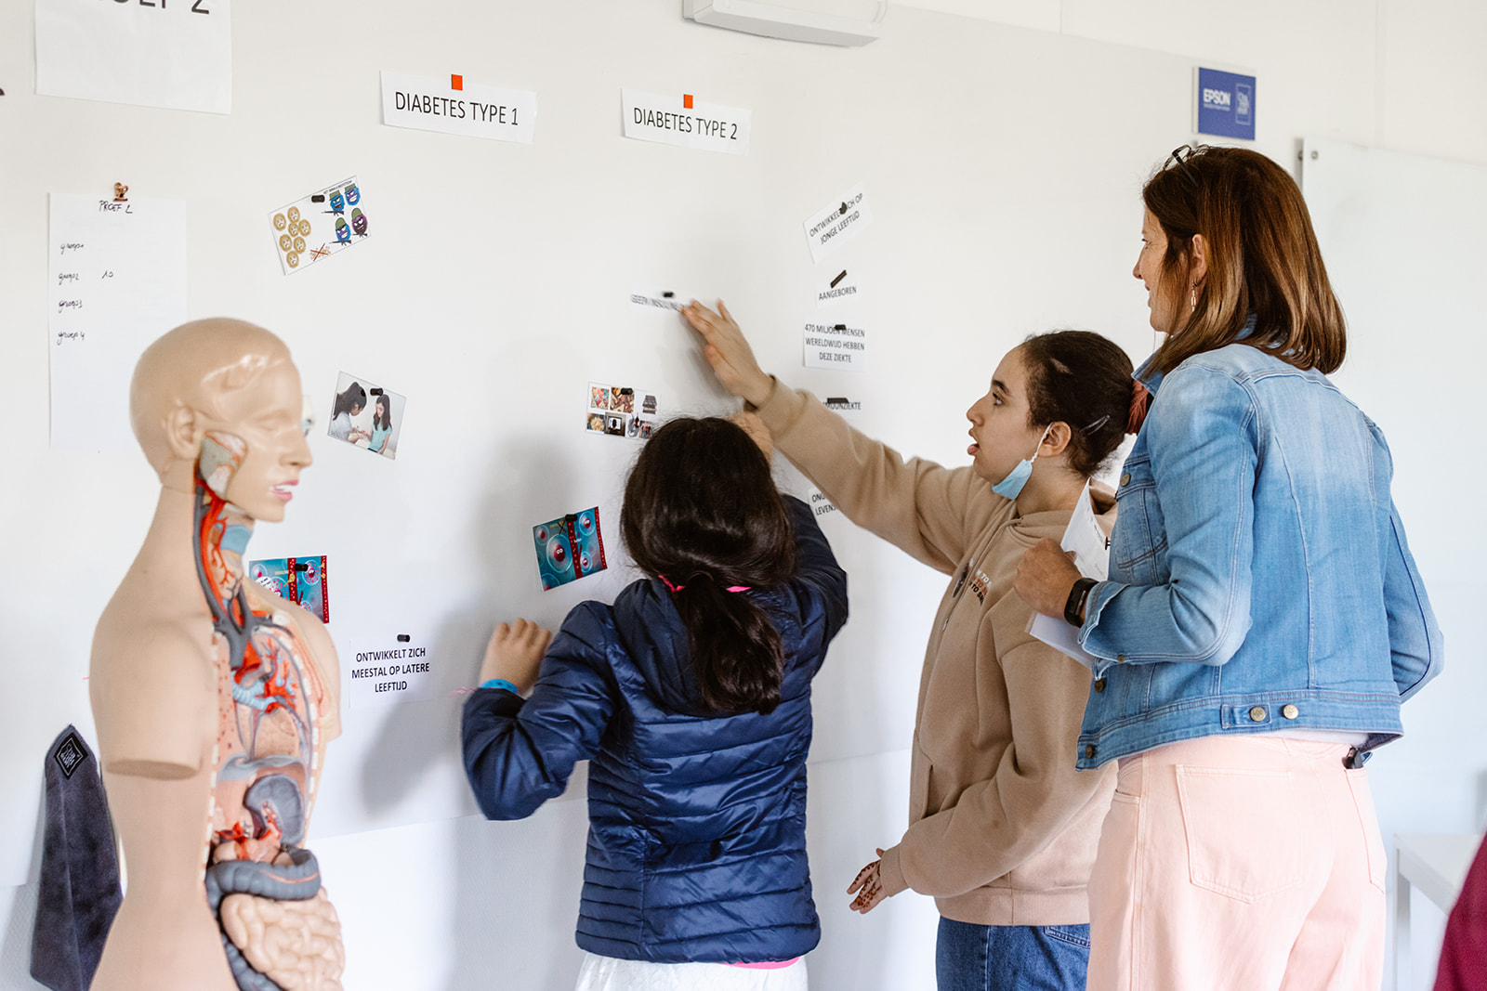

LOCATION AND TIME FLEXIBLE
WORKSHOPS AT SCHOOL
OR ON CAMPUS
Notes:
Campus or school
Workshop that are a bit shorter or longer
Supporting teachers to bring science into the classroom

Slide 5
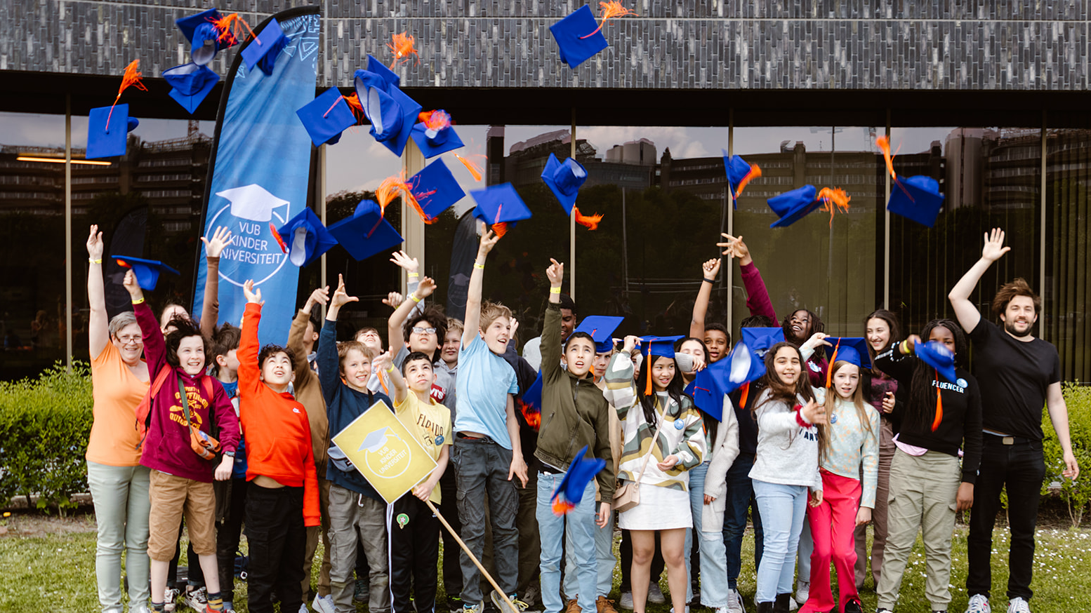

FREE OF CHARGE
THANKS TO FUNDING OPPORTUNITIES

Slide 6
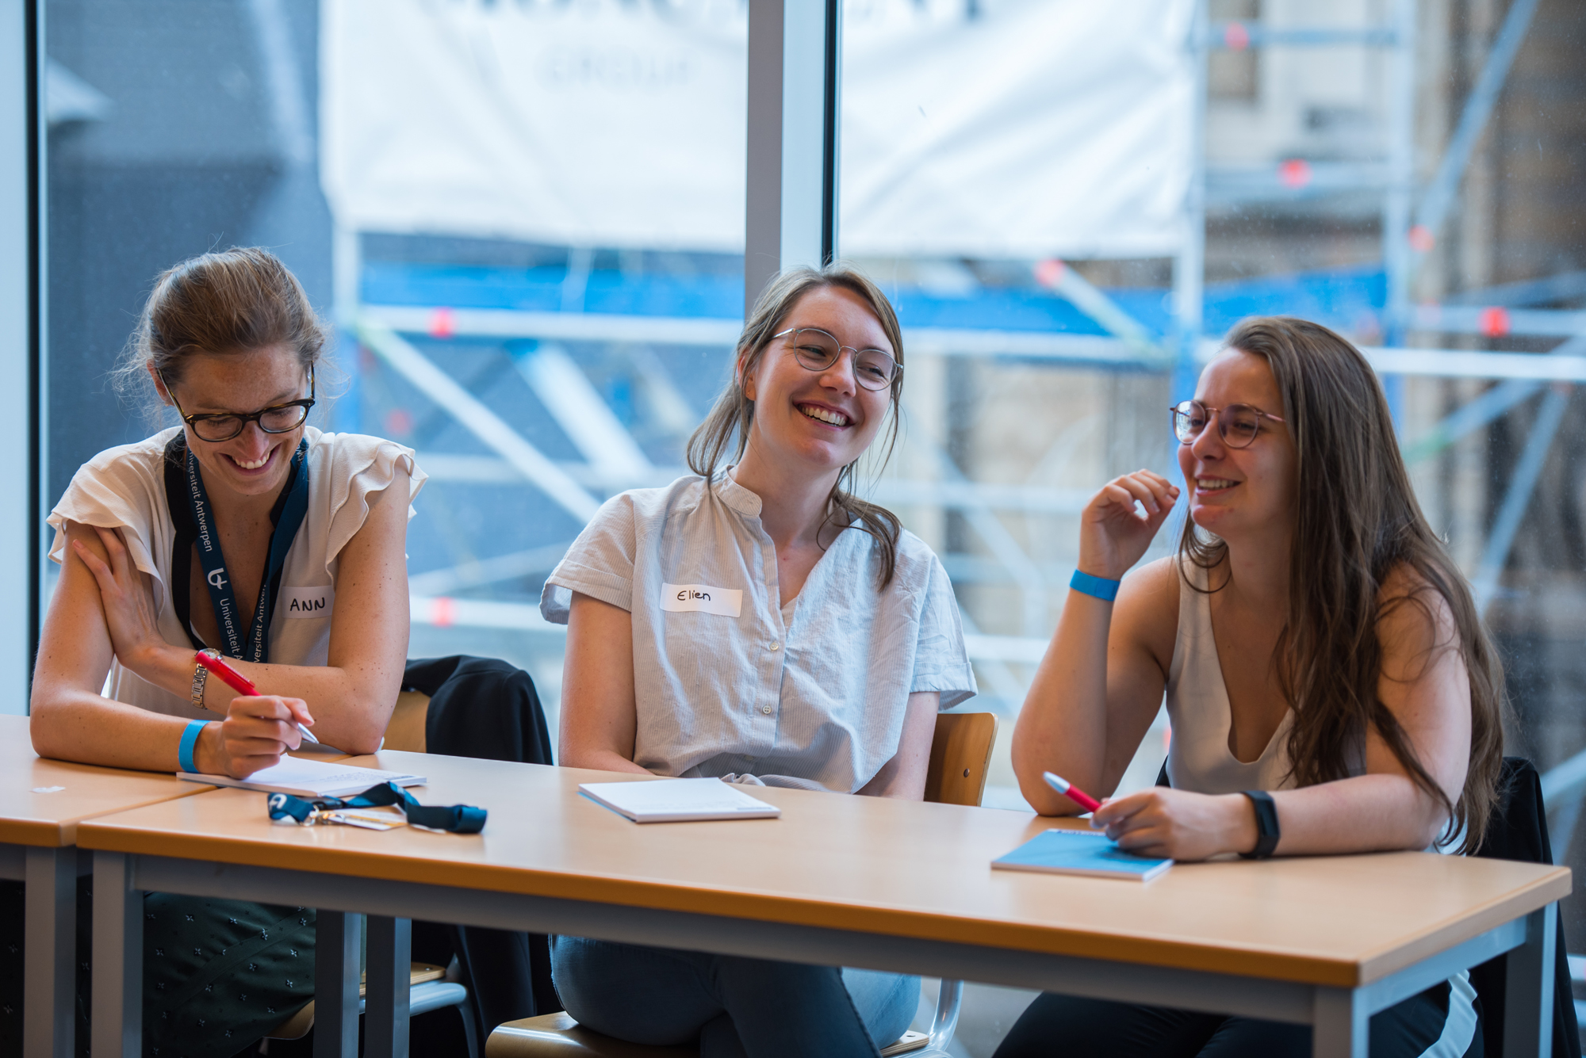
RESEARCHERS’ TRAINING
HOW TO MAKE A WORKSHOP FOR CHILDREN?
Notes:
At the beginning of the trajectory, participating researchers receive a hands-on training called: how do I make a workshop for children?
We give them tools to make a workshop for children age 10 tot 12, tailored to the multilingual context in Brussels.
After training the have feedback in group so they can use the other workshops as ‘inspiration’, and between these feedback sessions and the first workshops given we provide them with one-on-one feedback to make sure they are well supported.

Slide 7
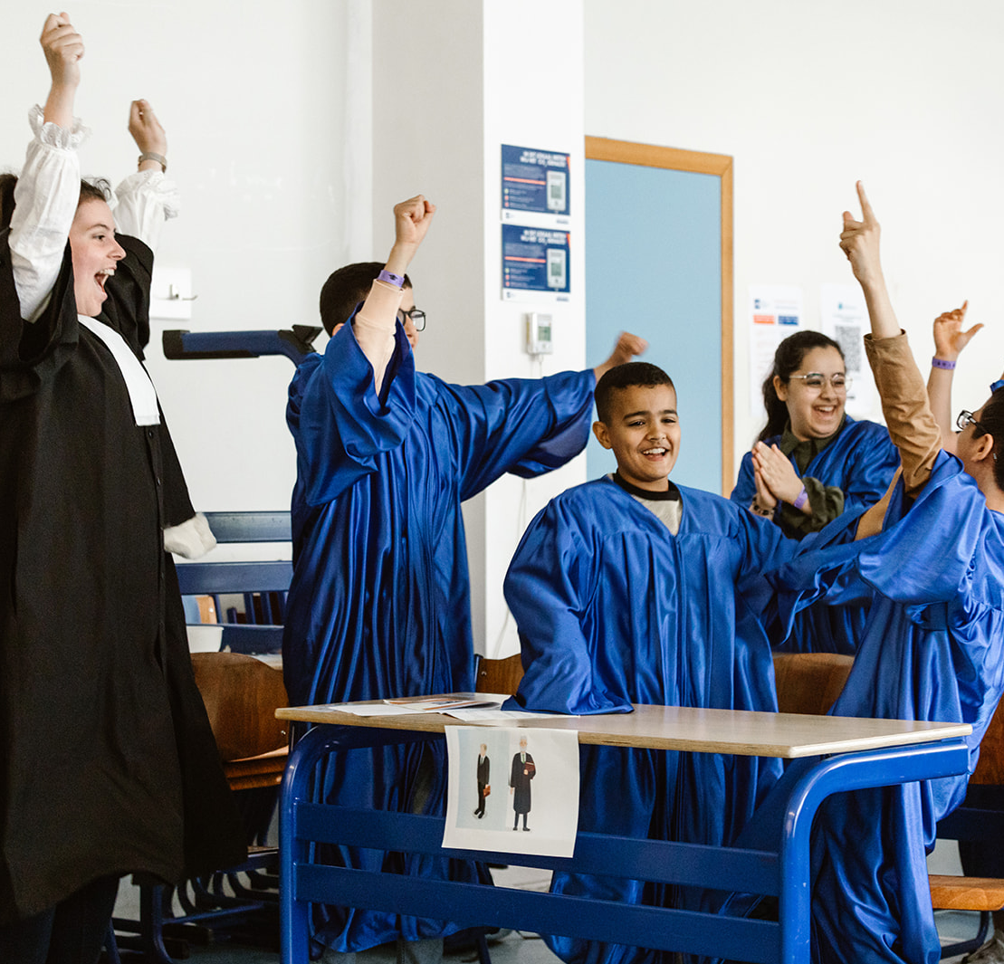
THANKS!
FEEL FREE TO CONTACT US TO EXCHANGE IDEAS OR TO ASK FOR MORE INFORMATION!
Fran.geys@vub.be
Sammy.leurs@vub.be

