Slide 1
SHORE in a nutshell
EmpOweR Students as the agents of cHangE
EUCU.NET Meeting 06.11.2023
Thomas Troy, Vienna University Children’s Office

Slide 2
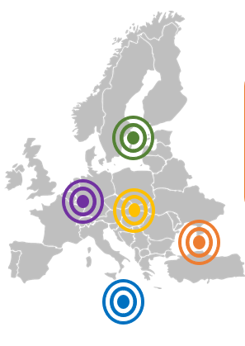
SHORE – Key facts
Call: HORIZON-MISS-2022-OCEAN-01
14 Consortium partners – Coordinator: Yildiz Technical University Istanbul
Duration: 36 Months
Objective: enhance ocean literacy resp. blue literacy of primary and secondary students and educators
5 different regional areas: Baltic Sea, Black Sea, Mediterranean Sea, Danube & Rhine River Area
Provide educational materials and conduct trainings for educators to increase their blue literacy knowledge
Grants for schools up to 10.000 Euro to implement blue school projects

Slide 3
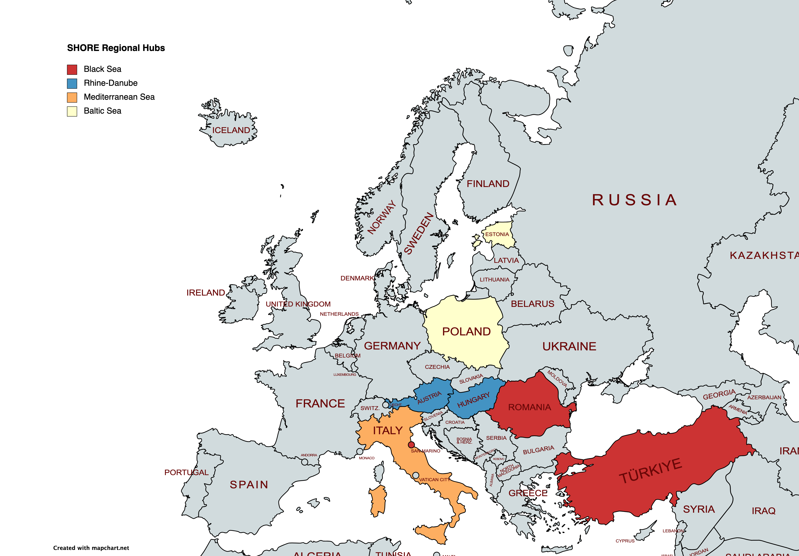
Setting up Country Hubs
Main idea: increase the impact of SHORE
support schools in their implementation process and offer guidance for educators and schools in their regional area
Materials and toolkits will be complemented by the CH → open schooling approach
Promote community activities such as exhibitions, meetNtalks, seminars to increase the awareness within the society

Slide 4
Spread the word to schools and participate!
3 open call periods:
  January 2024,
  September 2024
  May 2025
Project duration: 6 months
Detailed call criteria will be published within the next week(s)
  Schools have to join the European Network of Blue Schools
Topics:
  Sea-based activities (e.g. fishery, renewable energy, tourism)
  Biodiversity (e.g. microplastic, erosion and flooding)
  Hazardous substances and marine litter (e.g. oil rigs, waste)
  Climate change (e.g rising temperature, droughts, acidification)
End of each open call term: international public vote to honour the best school with the „Ocean Ambassador of the year“ award

Slide 5





Information box
thomas.troy@univie.ac.at
@shore-community
shore-community
shore.school.community
SHORE-Community

